Slide 1
Classification

Slide 2
Standards
SC.912.L.15.4 Describe how and why organisms are hierarchically classified and based on evolutionary relationships.
SC.912.L.15.5 Explain the reasons for changes in how organisms are classified.
SC.912.L.15.6 Discuss distinguishing characteristics of the domains and kingdoms of living organisms.

Slide 3
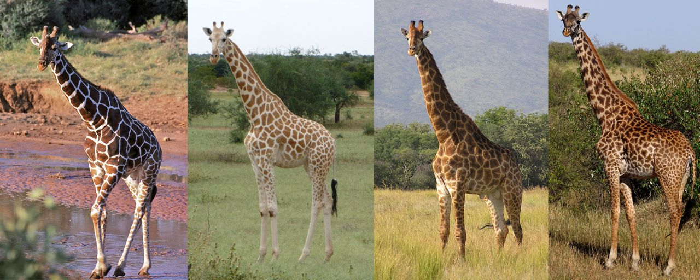
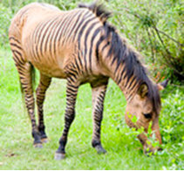
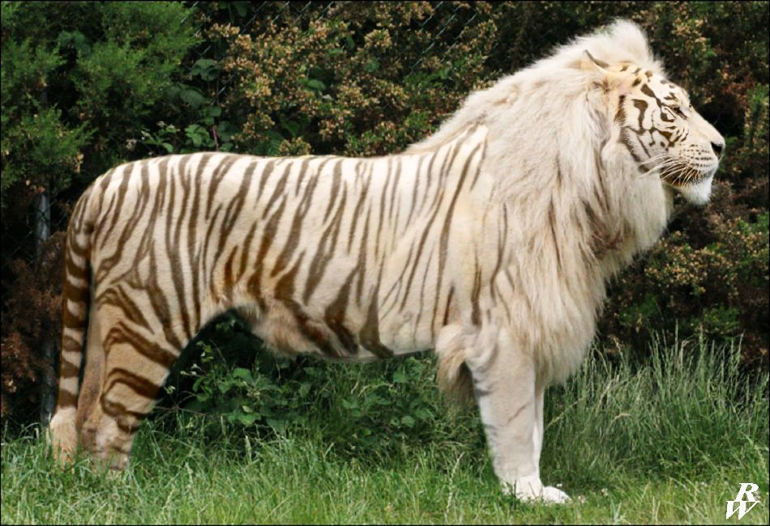
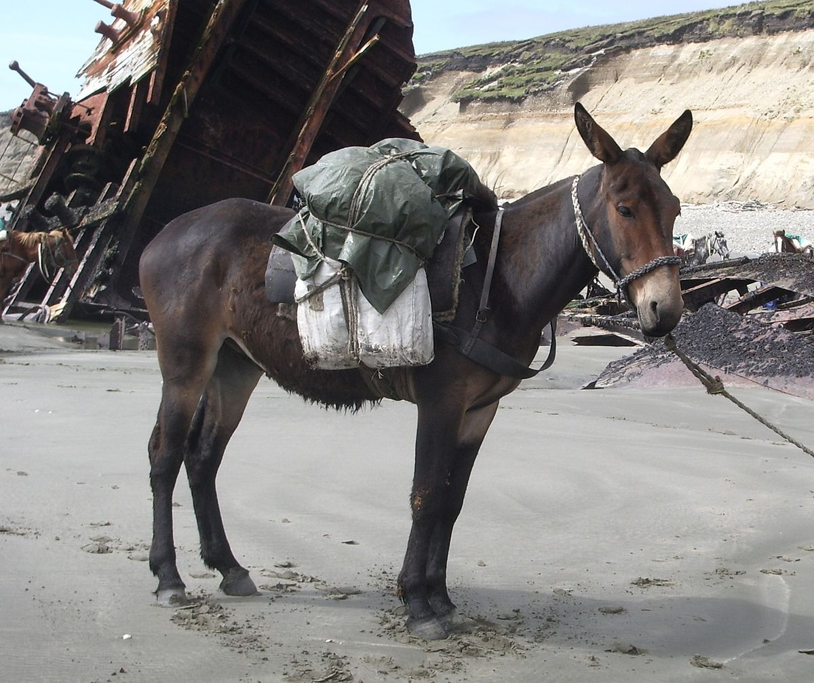
Vocabulary
Species - Populations of organisms that interbreed, or could interbreed under natural conditions (reproductive isolation)
Animals not considered their own species:
Zorses, ligers, mules, etc. These are hybrids and cannot produce viable offspring.

Slide 4
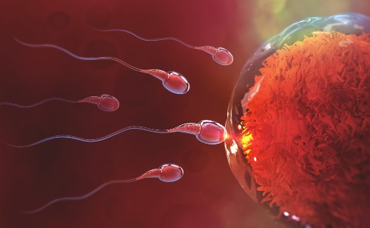
Vocabulary cont.
Pre-zygotic barriers – Physically impossible to mate or the gametes would never be able to meet. (before a zygote)
Example: A whale and a dog would never be able to produce an offspring together because their body structures would not allow for the gametes to ever meet.

Slide 5
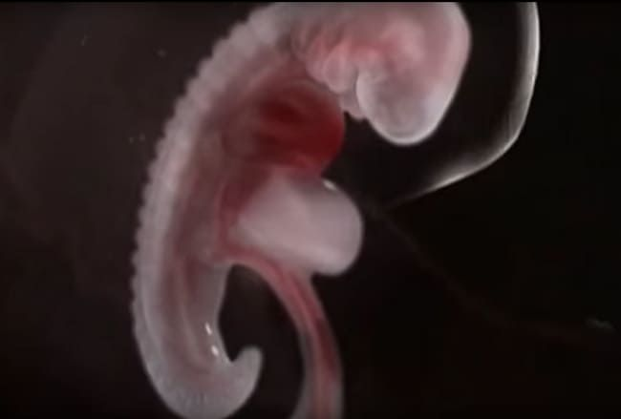
Vocabulary Cont.
Post-Zygotic Barriers – After the egg and sperm fuse their genetic material, the zygote does not survive (poor development) or the offspring are sterile. (after a zygote)
Chromosome numbers and/or content does not match and the resulting organism does not have enough/correct recipes for proteins
Mules (the offspring of a horse and a donkey) are sterile and cannot reproduce.

Slide 6
Vocabulary Cont.
Binomial Nomenclature – A 2 word naming system that includes the Genus and species names. The first word is capitalized, the second is lowercase.

Slide 7
Traditional Classification system
Domain
Kingdom
Phylum
Class
Order
Family
Genus
Species
Dear King Philip Came Over For Great Spaghetti – traditional memory device
Dumb Kids Playing Catch On Freeways Get Smashed – Mrs. Smith’s student generated version.

Slide 8
Vocabulary Cont.
Speciation – process where one species splits into two distinct species. Includes reproductive isolation (can no longer interbreed) and genetic divergence (each group’s DNA continues to change independently)

Slide 9
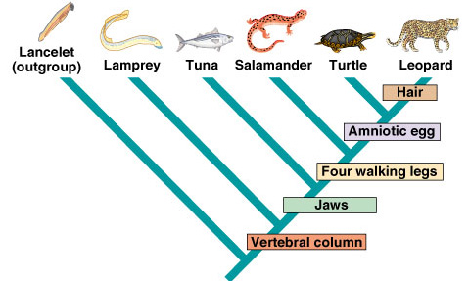
Vocabulary Cont.
Phylogeny – Evolutionary History
Cladogram – Evolutionary tree
Monophyletic group – all individuals are more closely related to each other than to individuals outside that group
Node – represents a speciation event (place where a common ancestor can be found)

Slide 10
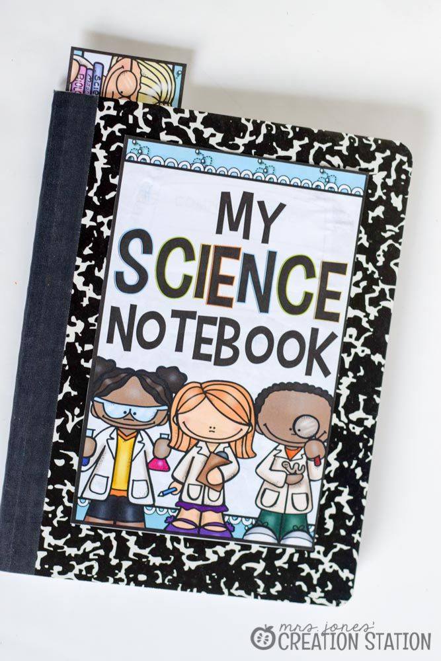
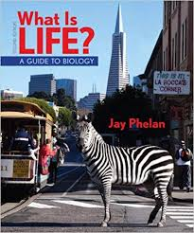
Materials -
Review with your shoulder partner or your conversation buddy:
What defines a Species?
What keeps species separate?
What is speciation?
What is the standard classification system?
What is phylogeny and how is it displayed visually?

Slide 11
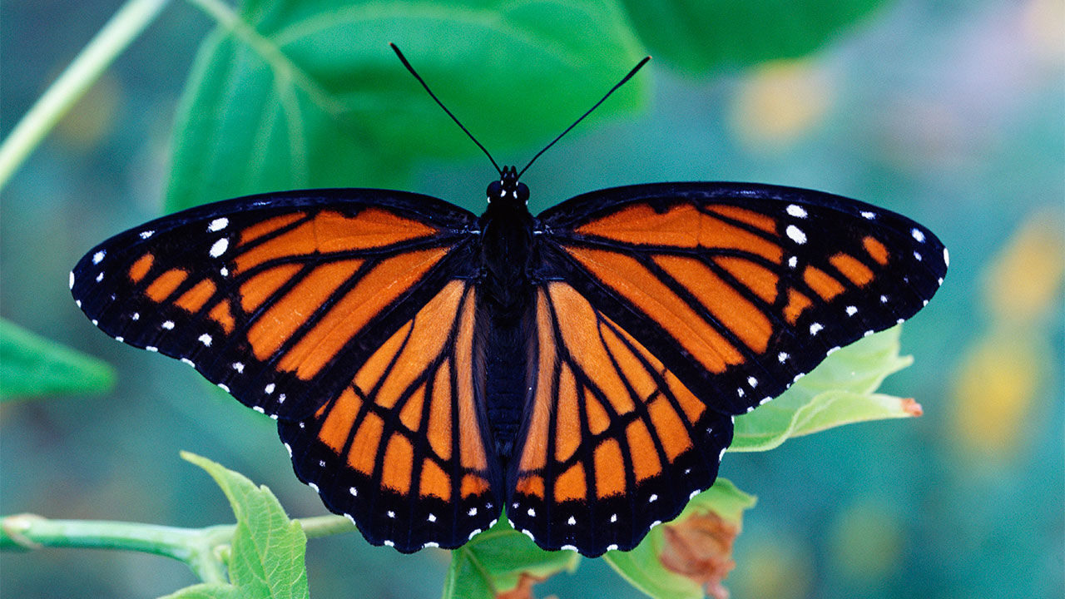
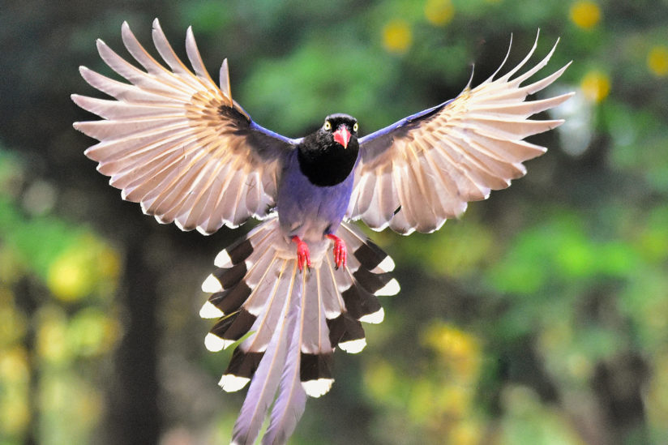
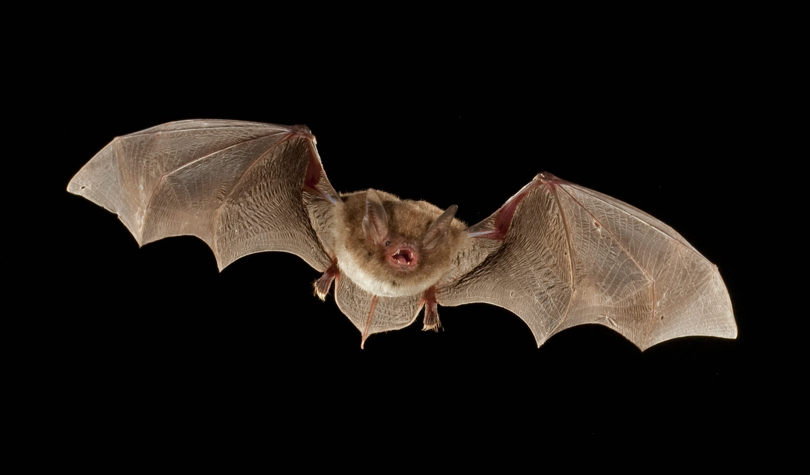
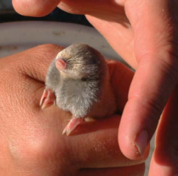
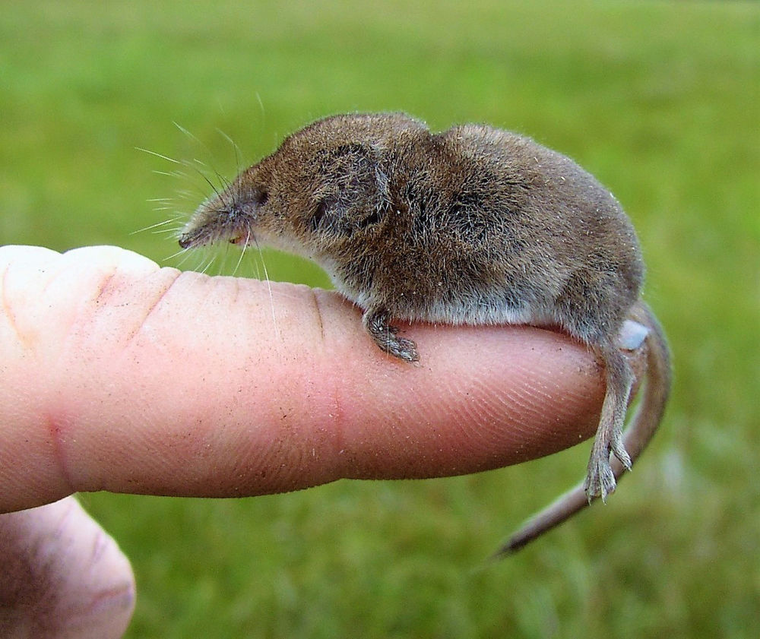
Old and new classification
Old – comparing physical traits and behaviors
Created charts showing family relationships based on 50 traits and behaviors. Not all scientists would use the same 50 traits, and family lines created were not the same.
Analogous structures made classifying very challenging.
Insects, birds and bats all fly, but are not recently related.
New – DNA Comparison
The more DNA sequences have in common, the more closely they are related.
Molecular clock concept and gel electrophoresis.
The African golden mole is actually more closely related to an elephant than the shrew.

Slide 12
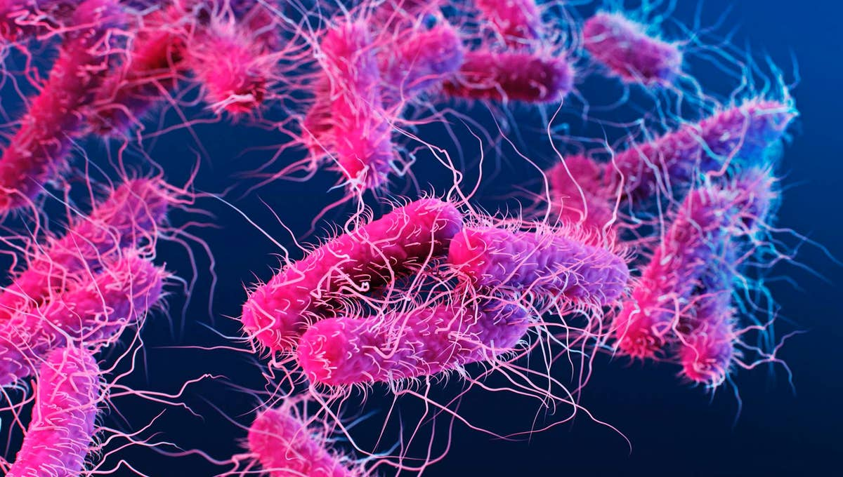
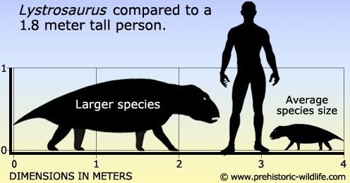
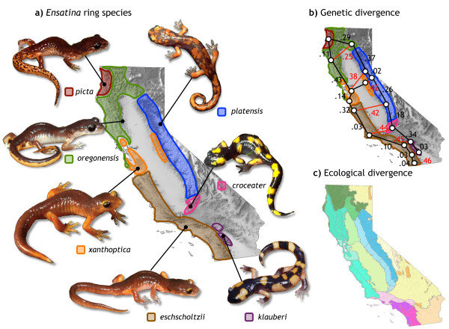
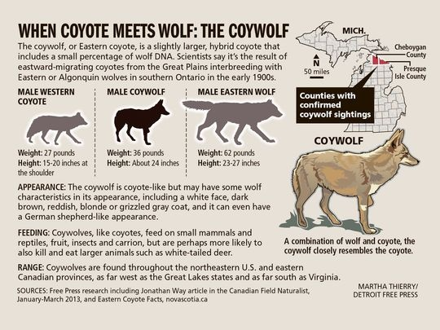
Challenges to classifying on the species concept: page 396
Asexual species
Fossilized/extinct species
Determining when one species has changed into another
Classifying ring species
Hybrid species that are not sterile

Slide 13
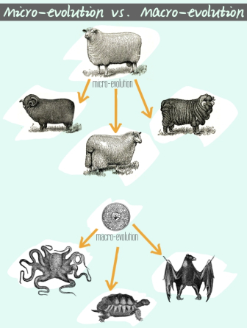
Vocabulary cont.
Micro-evolution - Small scale examples of evolution. (typically within the same species)
Ex. The increase in milk production in dairy cows in the 20th century
Macro-evolution – Large scale examples of evolution. (typically illustrating one species is the ancestor of another)
Ex. Producing a 200 ton dinosaur from rabbit sized reptile ancestors.

Slide 14
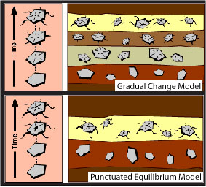
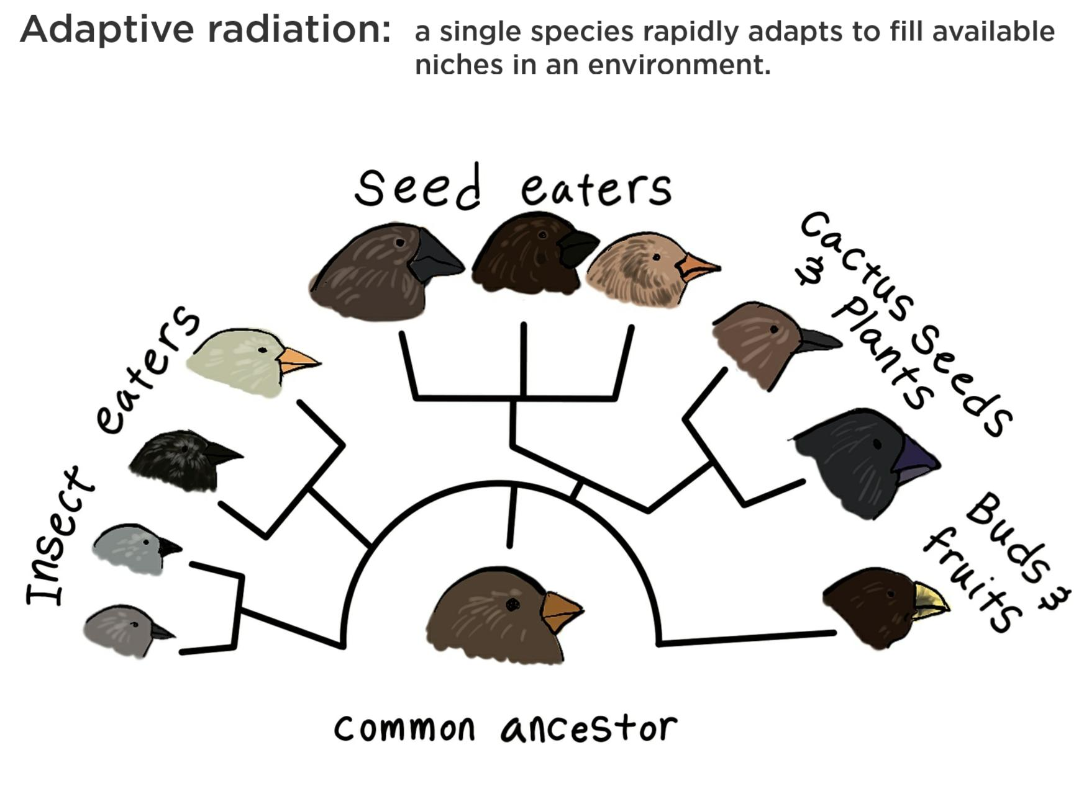
Punctuated equilibrium – When evolution occurs in a jerky fashion with large jumps interspersed between times of no or minimal change.
Adaptive radiation – Brief periods of time with a large number of speciation events.
Usually triggered by mass extinctions, colonization events (like Darwin’s finches), or evolutionary innovations like developing wings or exoskeletons.

Slide 15
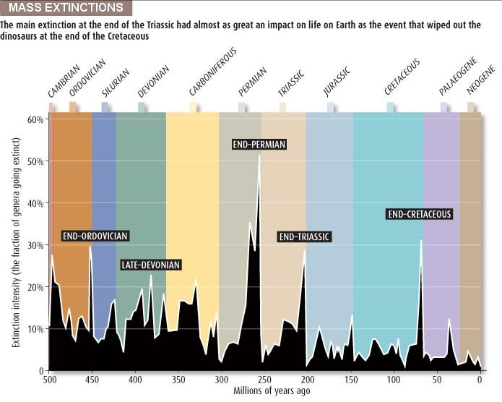
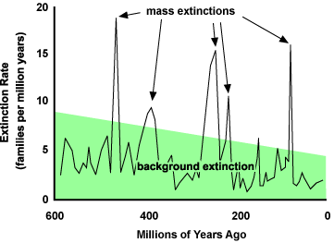
Vocab cont. Page 411
Mass extinctions – Large # of species becomes extinct over a short period of time due to extraordinary and sudden environmental change.
Scientists believe the earth has had 5 to 8 mass extinctions in the past, (the most recent killed the dinosaurs). Some think we are in the middle of one now, caused by humans.
Background extinctions – extinctions that occur at a lower rate during times other than mass extinctions.

Slide 16
Shoulder Partner/Conversation buddy review:
What changed about the way we classify and why?
What is the difference between Micro-evolution and Macro-evolution?
How is Adaptive Radiation different from punctuated equilibrium?
What is the difference between mass extinctions and background extinctions?

Slide 17
Domains (Chapter 13)
Eukarya
Fungi
Protists
Animals
Protists
Protists
Plants
Bacteria
Archaea

Slide 18
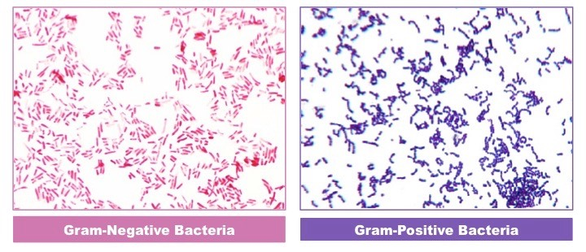
Domain: Bacteria
Single celled
Prokaryotic
Asexual reproduction
Classified by shape and DNA sequences
Peptidoglycan cell wall
Gram positive and Gram negative staining

Slide 19
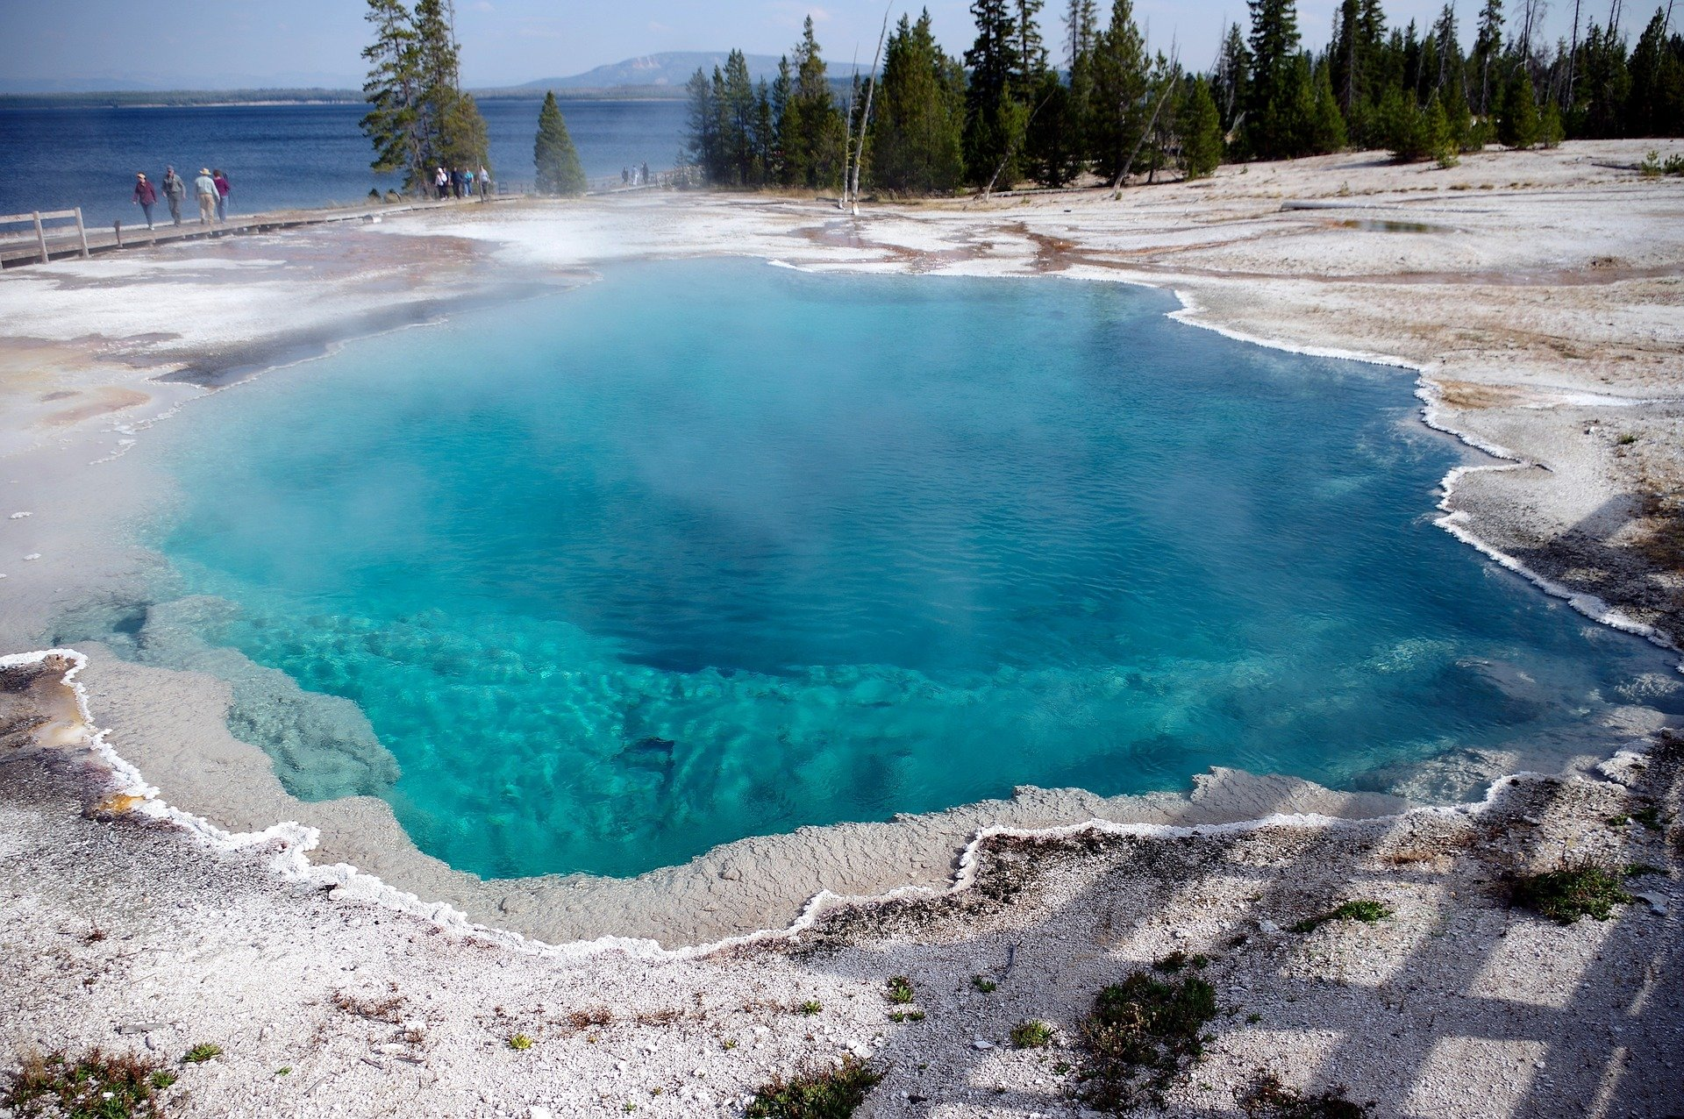
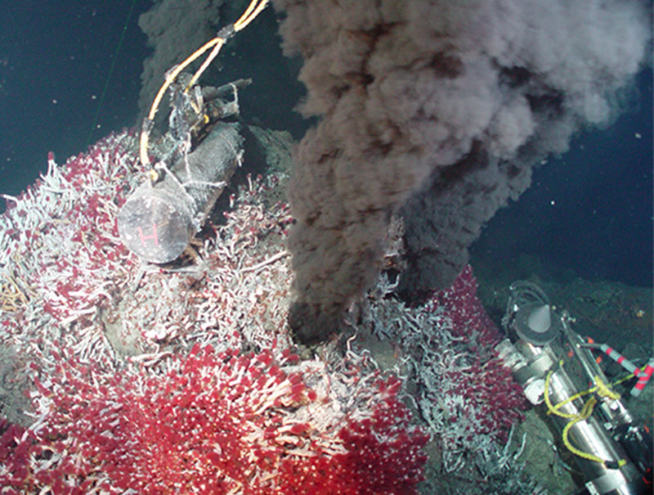
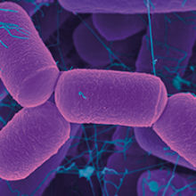
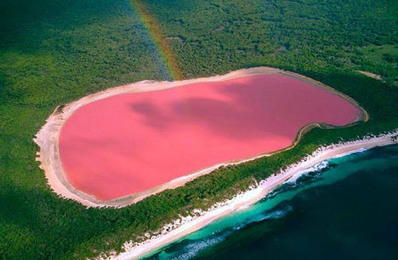
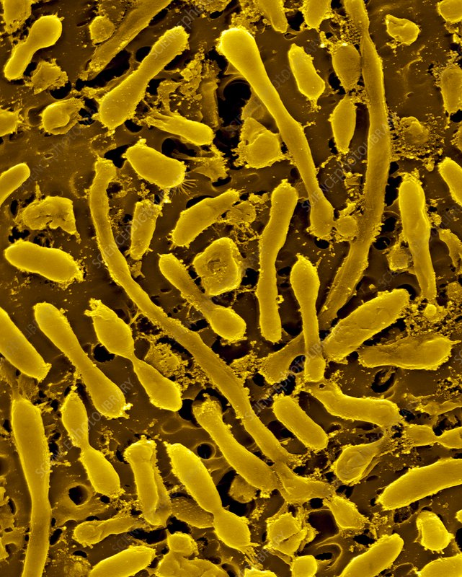
Domain Archaea
Single celled
Prokaryotes
Asexual reproduction
Many can survive in extreme environments
Divisions:
Thermophiles – “heat lovers” live in hot environments
Halophiles – Salt Lovers” live in salty environments like the Dead Sea
High and low pH tolerant acidophiles and basophiles
High pressure tolerant – found 4000M deep in oceans
Methanogens – anaerobic archaea that produce methane gas

Slide 20
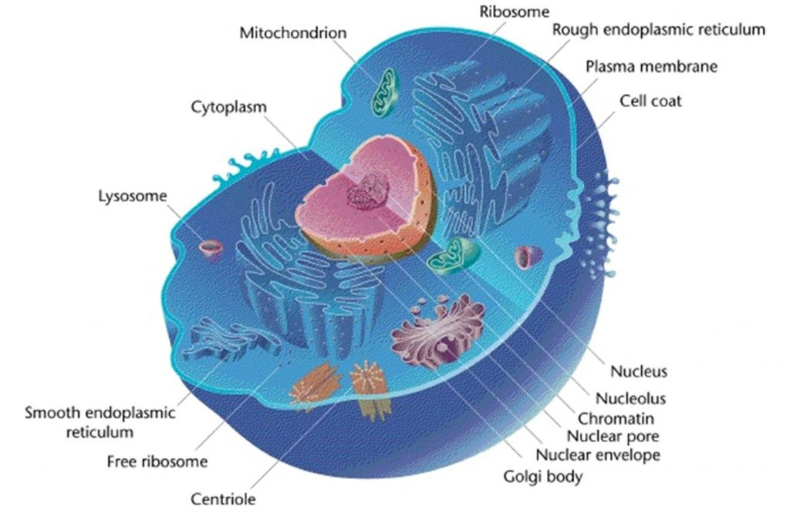
Domain: Eukarya
Single celled and multicellular organisms
Eukaryotic – Has membrane-bound organelles and nucleus
Asexual and sexual reproduction methods
4 main kingdoms
Fungi
Animals
Plants
Protists

Slide 21
Animal kingdom
9 Phylums:
Porifera (sponges)
Cnidarians
Platyhelminthes (flatworms)
Annelids
Mollusks
Nematoda (roundworms)
Arthropods
Echinoderms
Chordates

Slide 22
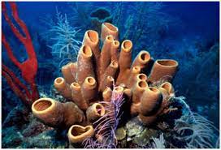
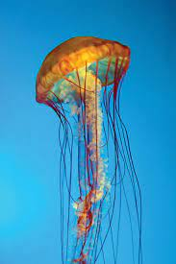
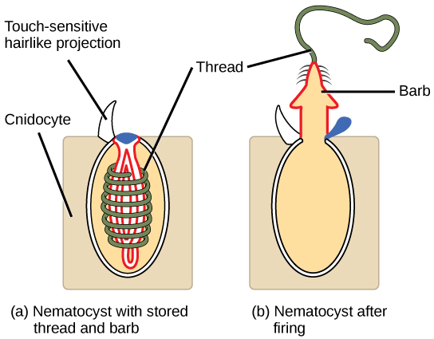
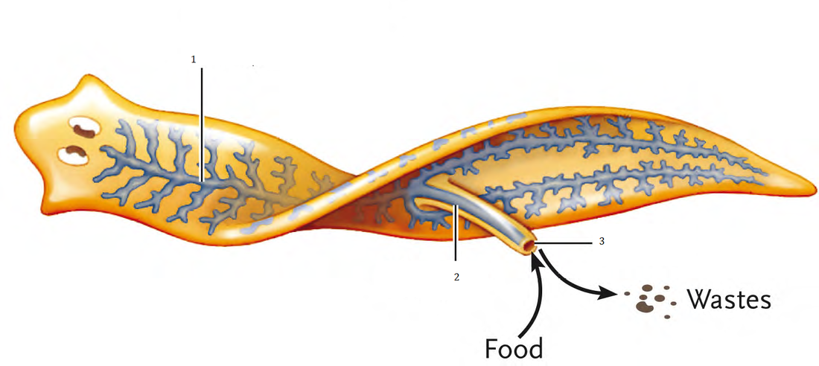
Porifera (sponges) -no specialized tissues or organs, hollow tube structure, filters water.
Cnidarians – Have radial symmetry, has cnidocysts (tiny barbs with toxin) poisonous. Ex. Jellyfish, coral
Platyhelminthes (flatworms) – no body cavity and only one opening for its gut. Hermaphroditic. Ex. Tapeworms, flukes

Slide 23
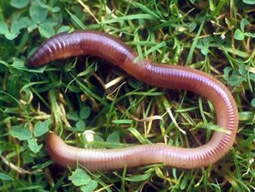
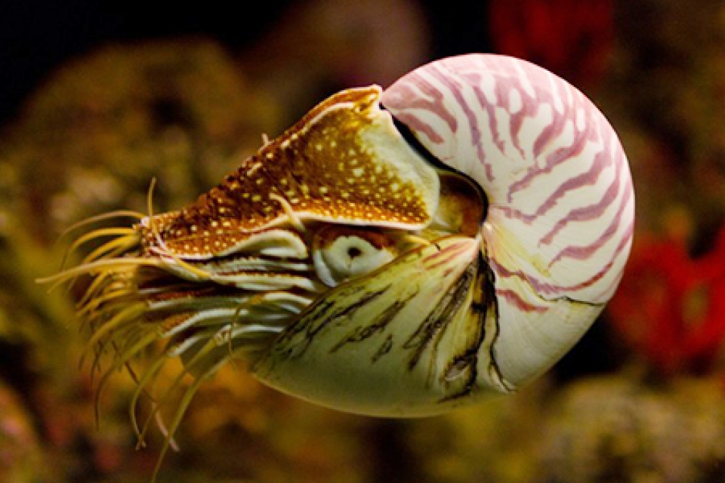
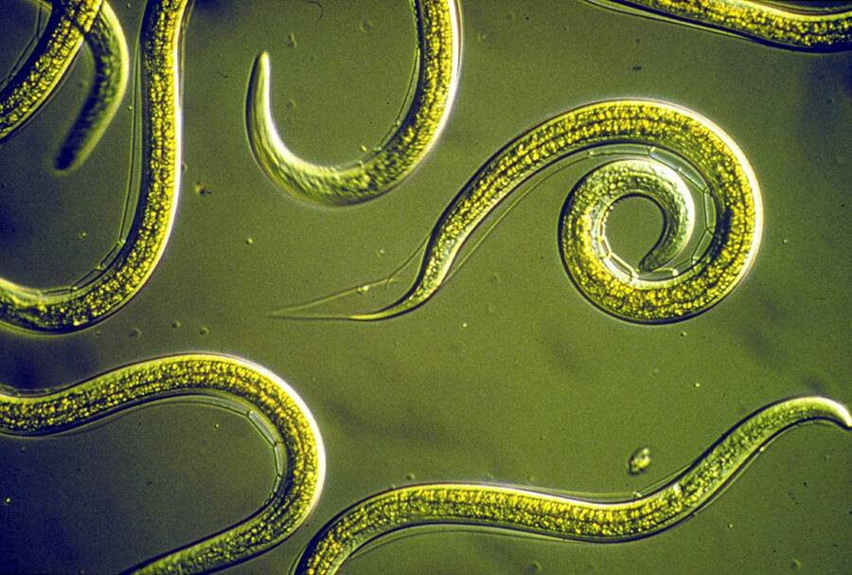
Annelids- segmented worms, body structure is sectioned off into segments. Ex. Marine worms, earthworms, leeches.
Mollusks – Most have a soft body and a shell for protection. Includes gastropods (stomach-foot), cephalopods (head-foot), and bivalves. Ex. Snails/slugs, squid/octopus, clams
Nematoda (roundworms) - grow by molting, typically very small. Long, narrow, unsegmented body surrounded by a cuticle 90,000+ species

Slide 24
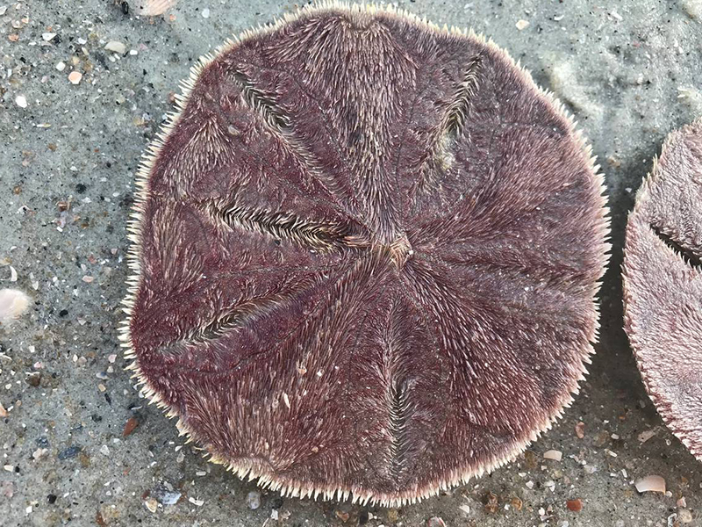
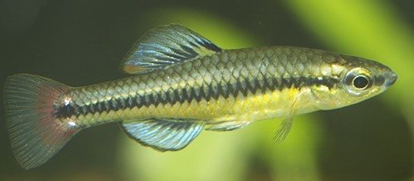
Arthropods – segmented body with a head, thorax and abdomen. Exoskeleton made of chitin, jointed appendages, many have life stages. Ex. Insects, spiders and crustaceans.
Echinoderms – hard skeleton under a spiny skin, adults are radially symmetrical, have tube feet. Ex. Sea stars, Sea urchins, Sand dollars
Chordates – Has a notochord, dorsal hollow nerve cord, pharyngeal slits, post-anal tail Ex. Tunicates, Lancelets, Vertebrates.

Slide 25
Review with your shoulder partner/conversation buddy

Slide 26
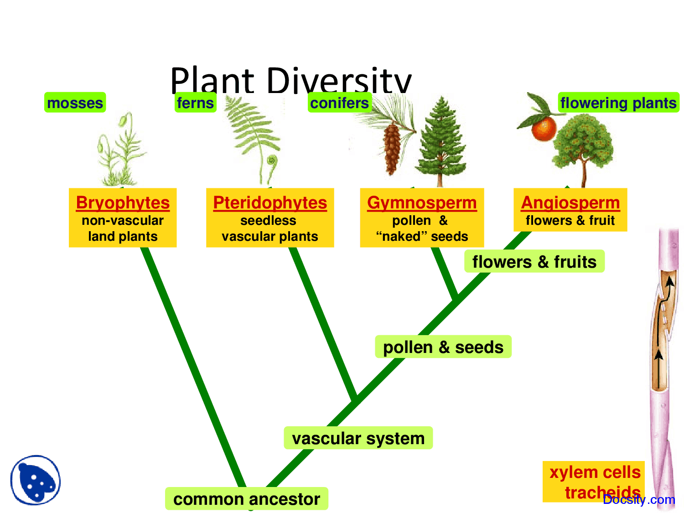
Plant kingdom
Non-Vascular seedless plants- no xylem or phloem tissue (uses diffusion). Has a cuticle to prevent water loss. Uses spores for gametes/reproduction.
Short plants (mosses, liverworts, hornworts)
Vascular seedless plants- Has Xylem/Phloem to transport nutrients and fluids. Reproduces with the use of spores.
Ferns and horsetails
Gymnosperms – Produce seeds via cones. Have vascular tissue. Fertilization produces seeds that grow into a new plant.
Conifers (pine trees)
Angiosperms – Produce seeds in an ovule, have flowers for reproduction. Has vascular tissue.
Flowering plants (trees, vegetables, fruits, herbs, etc.)

Slide 27
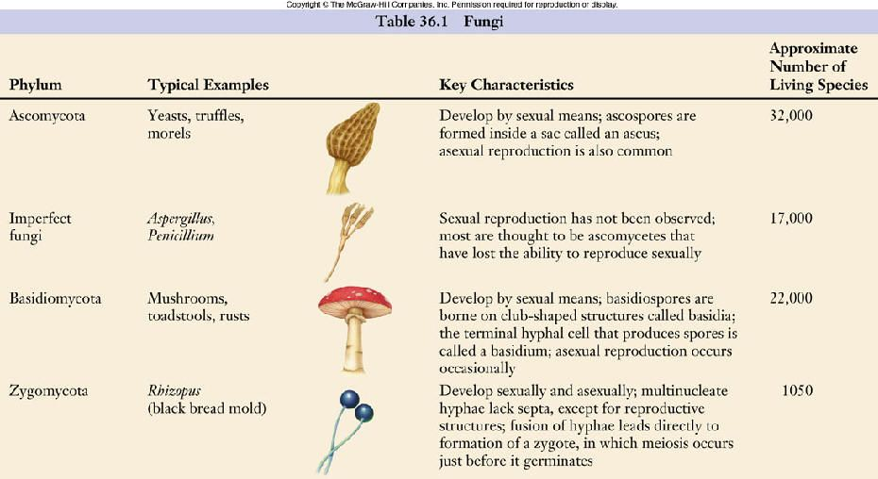
Fungi kingdom
Fungi are decomposers or symbionts. (heterotrophs)
Sessile – they are found on what they are eating.
Cell walls made of chitin,
Mushrooms, molds, and yeast.

Slide 28
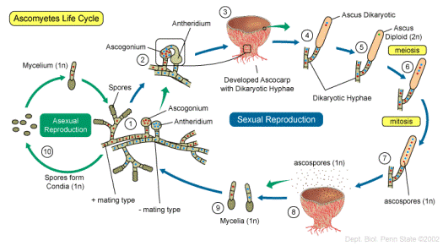

Slide 29
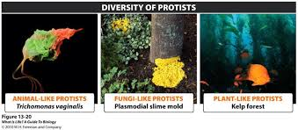
PRotists
Animal-like protists can move to find food and can catch their prey.
Includes: Paramecium
Fungi-like protists
Reproduce with spores and are sessile.
Some are very large and sessile. They divide by binary fission (plasmoial slime mold)
Plant-like protists
Grow in water and resemble plants.
Autotrophs
Most are unicellular, but some are multicellular.
Ex. Seaweed and algae

