Slide 1
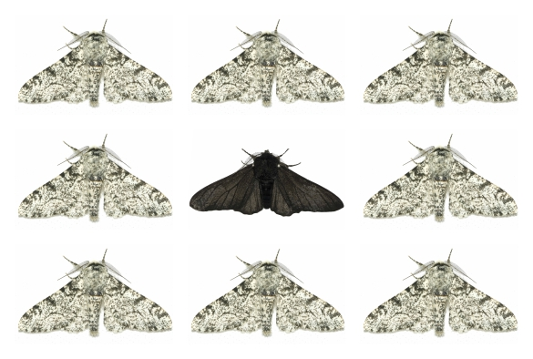
Evolution
The change in the frequency of alleles in a population (over time)

Slide 2
Review:
  SC.912.L.14.5 Explain the evidence supporting the scientific theory of the origin of eukaryotic cells (endosymbiosis).
  SC.912.L.15.15 Describe how mutation and genetic recombination increase genetic variation.
New:
  SC.912.L.15.8 Describe the scientific explanations of the origin of life on Earth.
  SC.912.L.15.1 Explain how the scientific theory of evolution is supported by the fossil record, comparative anatomy, comparative embryology, biogeography, molecular biology, and observed evolutionary change.
  SC.912.L.15.10 Identify basic trends in hominid evolution from early ancestors six million years ago to modern humans, including brain size, jaw size, language, and manufacture of tools.
  SC.912.L.15.13 Describe the conditions required for natural selection, including: overproduction of offspring, inherited variation, and the struggle to survive, which result in differential reproductive success.
  SC.912.L.15.14 Discuss mechanisms of evolutionary change other than natural selection such as genetic drift and gene flow.
  SC.912.L.15.2 Discuss the use of molecular clocks to estimate how long ago various groups of organisms diverged evolutionarily from one another.
  SC.912.L.15.3 Describe how biological diversity is increased by the origin of new species and how it is decreased by the natural process of extinction.

Slide 3
Biogenesis = The concept that life comes from other living organisms.
Bio=life
Genesis = the beginning
Before the mid 1600’s, people had some strange ideas of where organisms came from.
  Many subscribed to the idea that living organisms spontaneously came from inanimate objects.
    If you put dirty laundry in a vase in a dark corner of a room, it would generate mice.
    Rats spontaneously generate from hay
    Bees spontaneously generate from dead animal carcasses
    Frogs spontaneously generate from mud

Slide 4
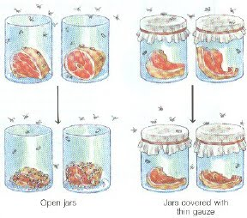
Scientists that designed experiments in support of Biogenesis.
Francisco Redi - Mid 1600’s
  Designed an experiment to show that flies do not spontaneously generate from rotting meat.
  Put meat in jars. He left some uncovered, and covered some.
  The opened jars had maggots growing on the meat. The jars with the gauze had maggots growing on the gauze, but none on the meat.
  Spontaneous generation

Slide 5
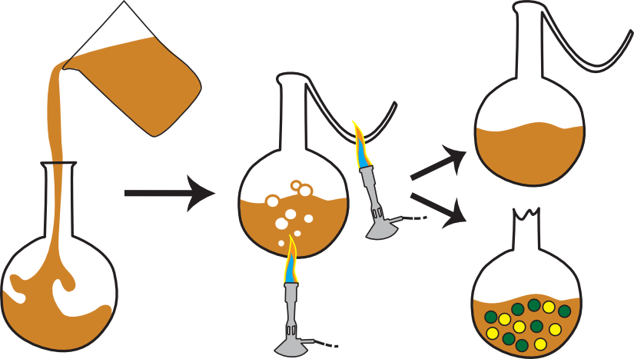
Louis Pasteur - Mid 1800’s
  Lost 3 of his 5 children to disease. He waged war on disease.
  Because bacteria are microscopic, people thought that bacteria spontaneously generated from the air.
  Pasteur put broth in gooseneck flasks and boiled it to kill all existing bacteria. Some flasks were left in tact. Some had the gooseneck flask portion broken off and allowed access to the air and falling airborne bacteria. The open flasks became contaminated with bacteria, and the gooseneck flask broth did not spoil.
    Spontaneous generation

Slide 6
Abiogenesis – Life comes from non-living factors
Prefix “a” means without abio= without life
Oparin – Wrote “the origin of life”
  1924 He hypothesized that life evolved from layers of organic chemicals in the ocean as a product of Earth’s early atmosphere.
  Unable to find a way to test his hypothesis.
Urey- Miller 1953
  23 year old student and professor designed glassware to test Oparin’s hypothesis of the “warm little pond”

Slide 7
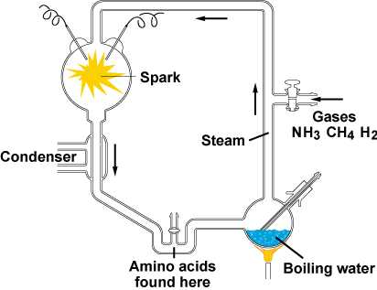
Urey- Miller 1953
  23 year old student and professor designed glassware to test Oparin’s hypothesis of the “warm little pond”.
  In a matter of days, they found amino acids in the water. (building blocks for proteins)

Slide 8
Lynn Margulis – 1967 developed the endosymbiotic theory.
  Chloroplasts and mitochondria were likely consumed by larger cells.
Sidney Fox -1958
  Constructed proteins by heating and drying amino acids. He also heated proteins in water and found that they made microspheres.

Slide 9
Other hypotheses
RNA world hypothesis –
  RNA developed first to form recipes for proteins, and later DNA would be formed as a more stable master recipe book.
Panspermia – Meteor crashing to Earth with microbes on it. The microbes survive and multiply.
Odds of life creating itself on Earth are 1 in 10^{90,000}
  Fred Hoyle equates that to the likelihood of a tornado blowing through a junkyard and assembling a working 747 jet as it leaves. (not a test question, but used for perspective)

Slide 10
Partner practice
Explain in your own words:
  The experiments in support of Biogenesis
  The efforts to create hypotheses and theories in support of Abiogenesis.
Great a mnemonic device, or link to another piece of learned information to improve memory recall.

Slide 11
Who was Charles Darwin?
Not a strong student in school. His father wanted Charles to become a physician like himself. Charles dropped out of medical college due to the gruesomeness of surgery.
His father enrolled Charles in seminary school to become a priest. Charles became interested in geology and biology.
Charles Darwin took his first job as a “Gentleman’s Companion” on the HMS Beagle in 1831.
  This was a 5 year expedition to map and catalog findings
  Travels included the southern coast of South America and the Galapagos Islands 600 miles off the coast of Ecuador (West Coast of South America).

Slide 12
What were Darwin’s observations?
Darwin saw the fossil of a Glyptodont (extinct). It looked like a 10 ft long armadillo on southern coast of South America.
Galapagos finches
  Ground finch – had large beaks to eat tough seeds
  Warbler Finch – had long skinny beaks to retrieve food
Giant Tortoises
  Tortoises that ate from the ground had rounded shells
  Tortoises that ate from shrubs and trees had saddle shaped shells that allowed their necks to reach higher.

Slide 13
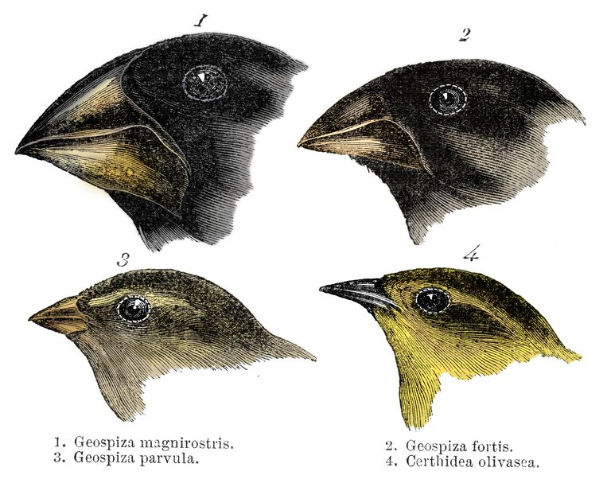
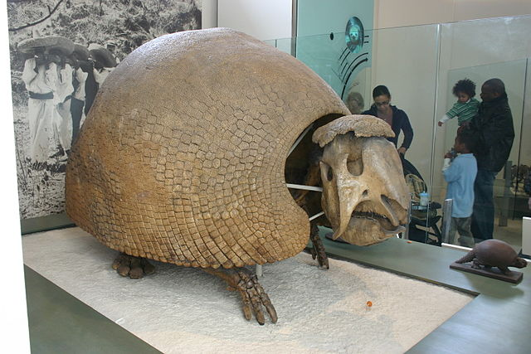
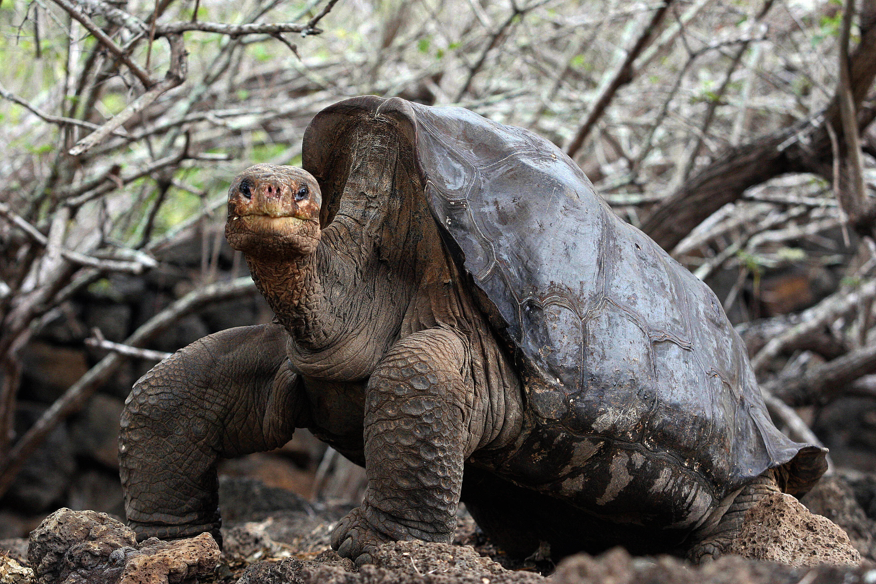
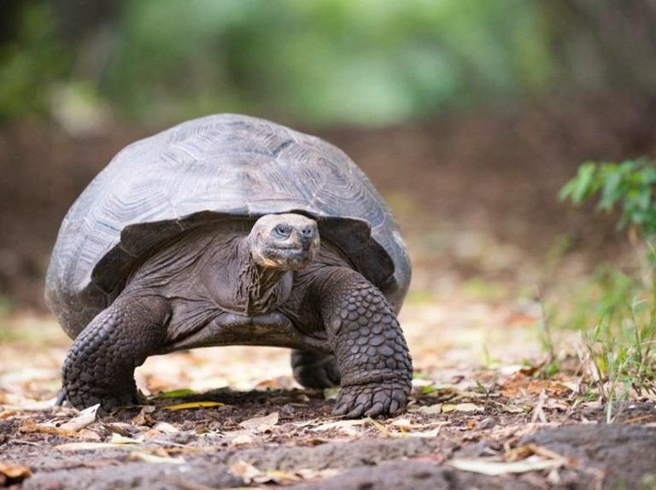

Slide 14
Darwin’s Theory – Natural Selection
Often called “Survival of the fittest”
A change in allele frequencies that occurs when individuals with one version of a heritable trait have greater reproduction success than individuals with a different version of that trait (in a natural environment).

Slide 15
Evolution by Natural Selection requires 3 conditions:
There must be a variation for a trait within the population
The variation for the trait must be heritable
Overproduction of offspring with the trait.
Darwin was not excited about releasing his theory of Natural Selection. He faced disgrace from society. He put his theory in a desk drawer for 14 years until Alfred Russel Wallace independently came up with the same theory. Darwin had more evidence and published a book, so he is the one the credit is awarded to.

Slide 16
There are 4 causes for evolution Pg.309
Natural Selection
Mutation
Migration
(Gene flow)
Genetic Drift

Slide 17
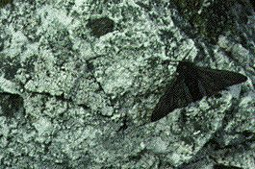
Natural Selection
Variation of a heritable trait provides an organism with and improved “fitness” within their natural environment.
  Ex. Camouflage against predators or easier to obtain food.

Slide 18
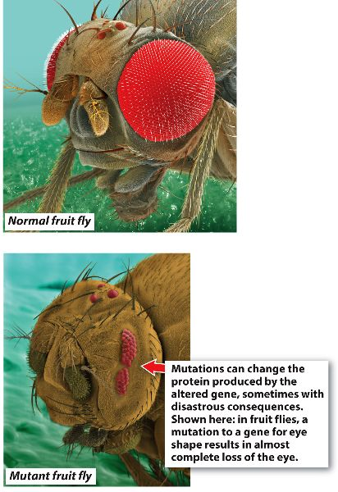
Mutation
An alteration of the base pair sequence in the DNA of and individual’s gamete-producing cells that changes an allele’s frequency in a population.
  Most mutations decrease an organisms reproductive success or “fitness”

Slide 19
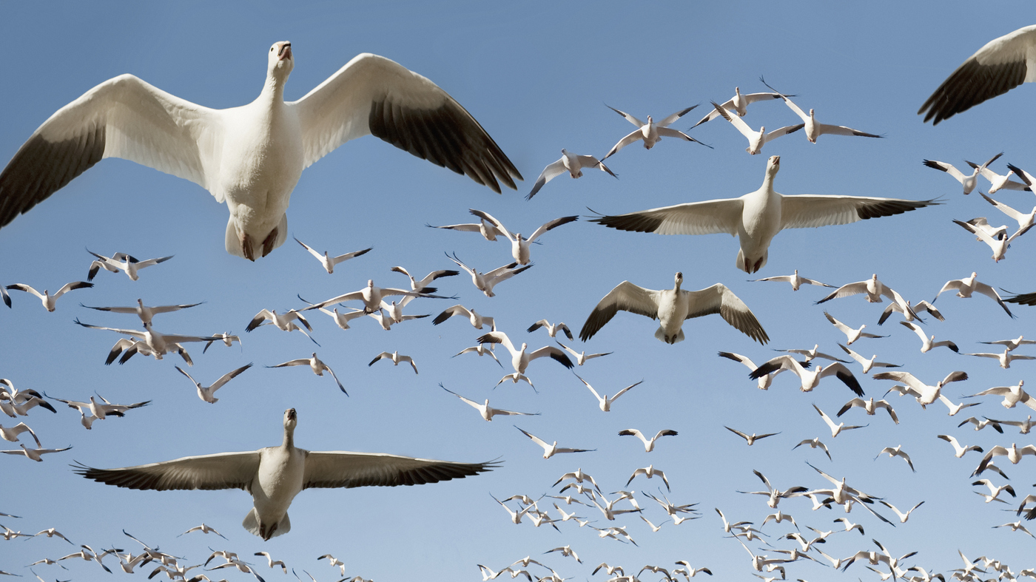
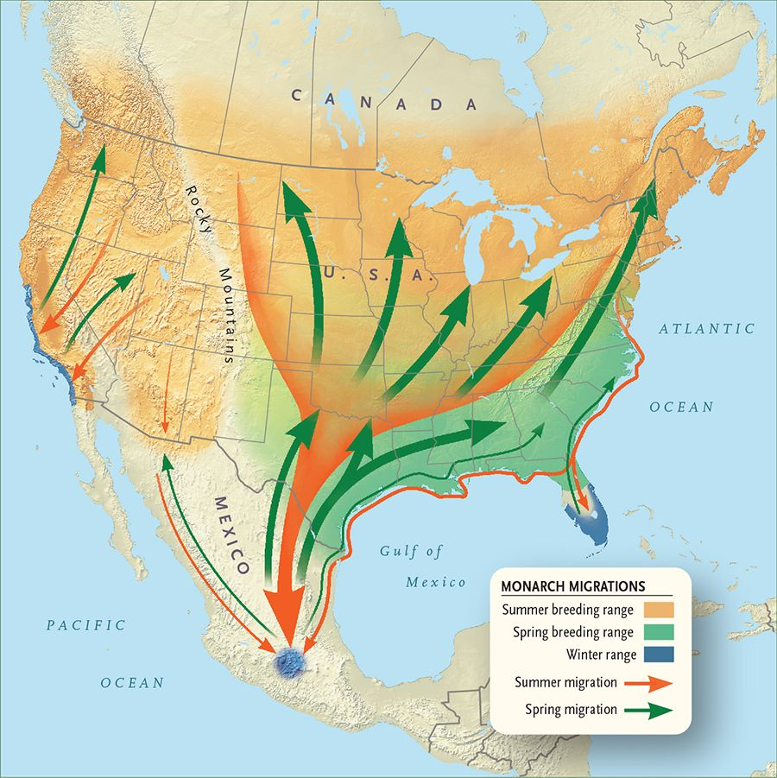
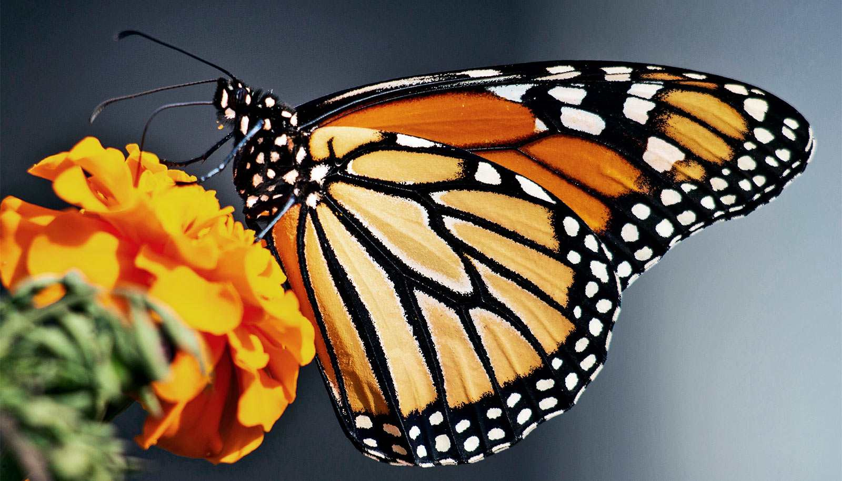
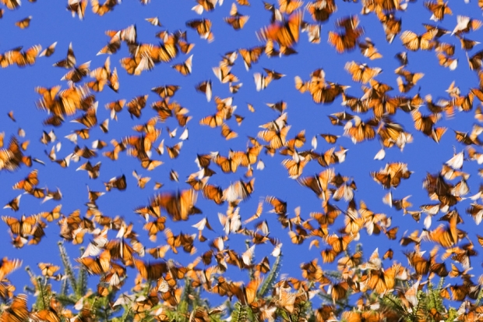
Migration (Gene flow)
A change in allele frequencies caused by individuals moving into or out of a population.

Slide 20
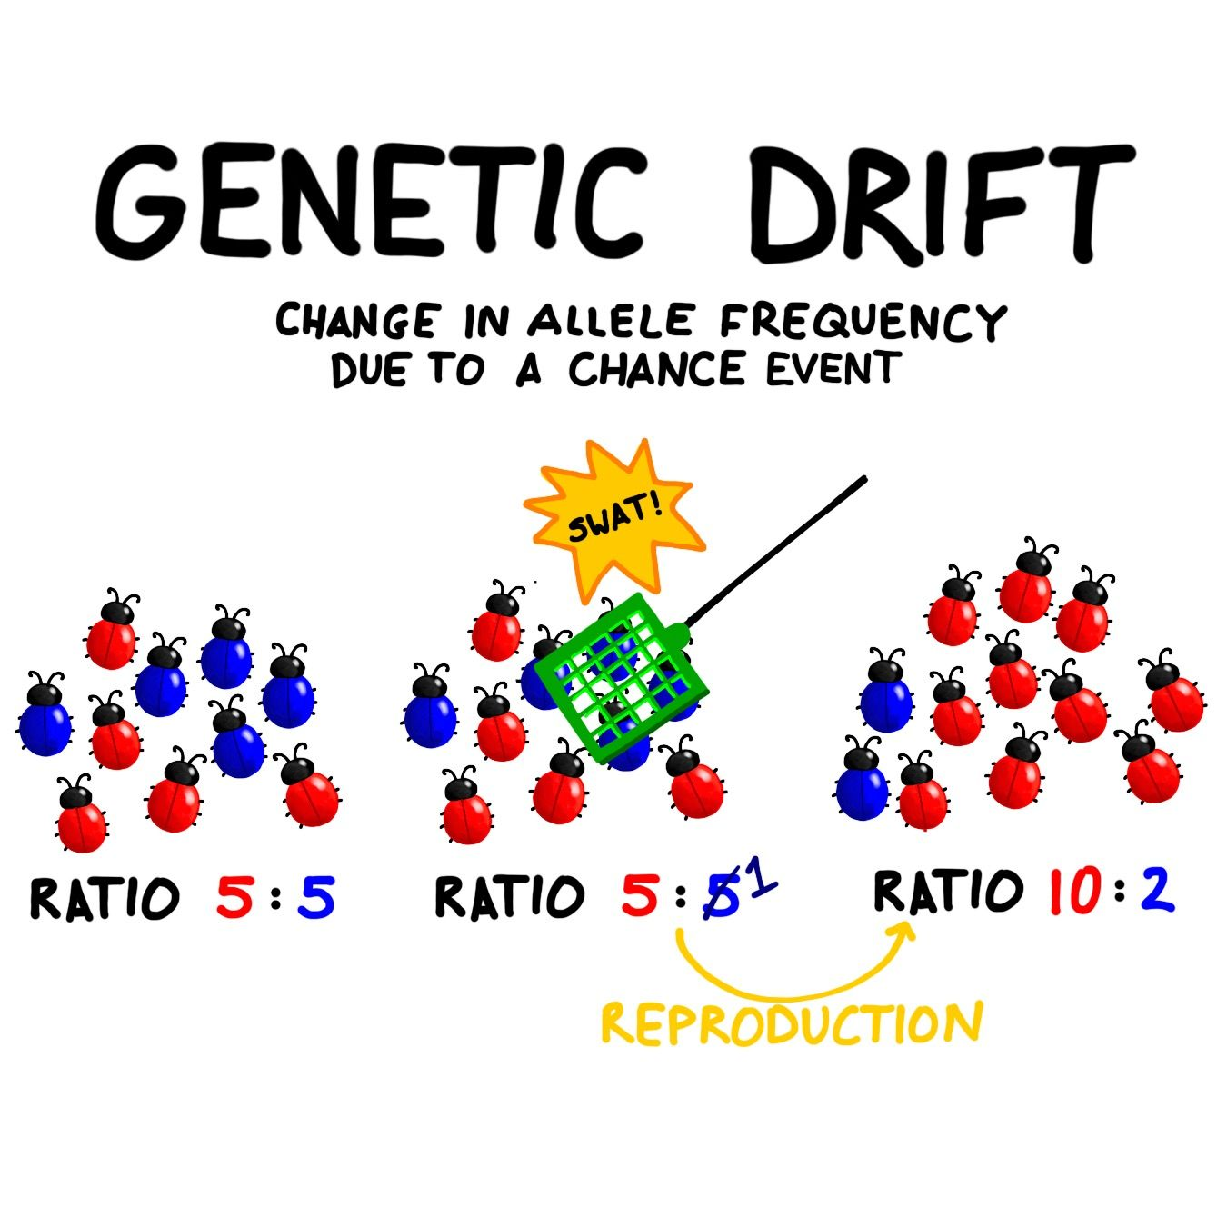
Genetic Drift
A random change in allele frequencies unrelated to any allele’s influence on reproductive success. (allele frequency changed by chance, like rolling of the dice)
Founder effect – A small number of individuals start a new population somewhere else.
  Ex. Amish Population and polydactylism
Population bottleneck – removal of a large percent of the population that results in a reduced variation in species
  Ex. Cheetahs and near extinction

Slide 21
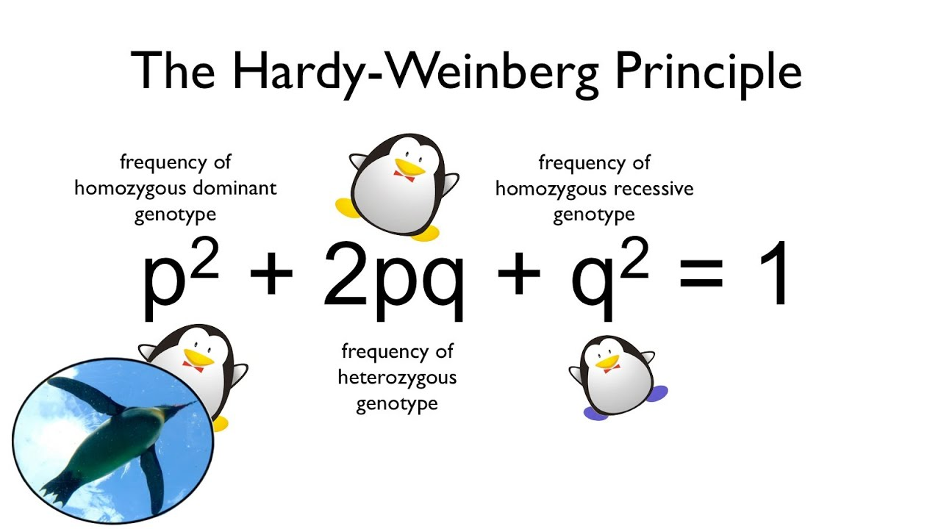
Hardy Weinburg equilibrium
Assumes random mating, and no evolution (natural selection, mutations, migration) occurring.
Allele frequencies must be known for the population.
The population must be large.
Population allele frequencies can be predicted, which makes a good base line for comparing to see if evolution is occurring.

Slide 22
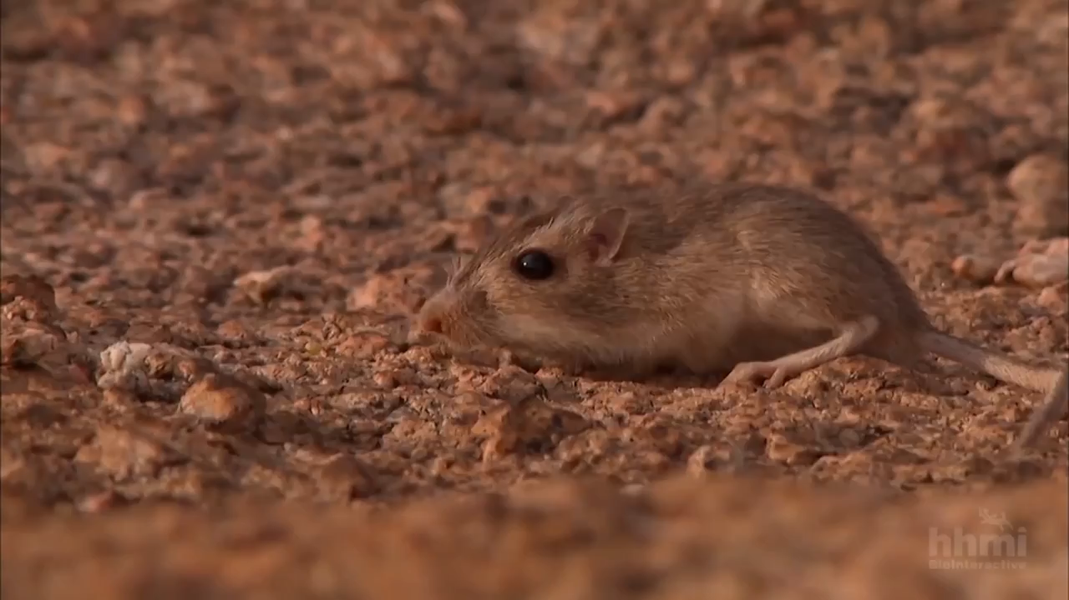
Adaptation
The process that organisms become better matched to their environment through natural selection.

Slide 23
Natural Selection does not equal organism perfection because:
Environments change
Relies on random mutations (remember, most are harmful and not helpful)
Alternate alleles may also have equal “fitness”. ( There’s more than one successful option.

Slide 24
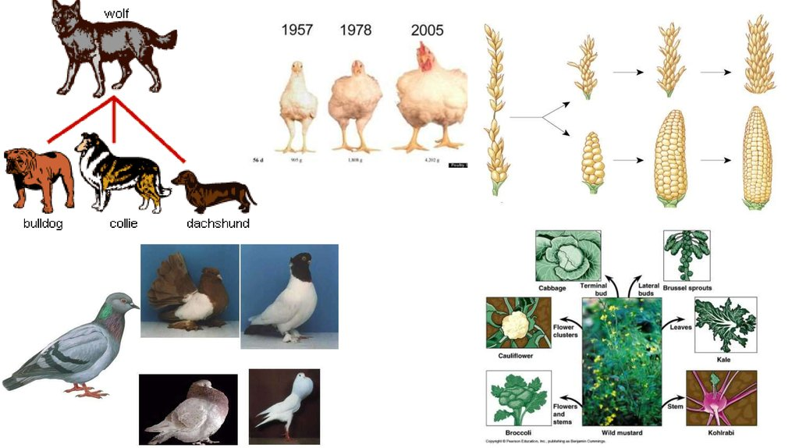
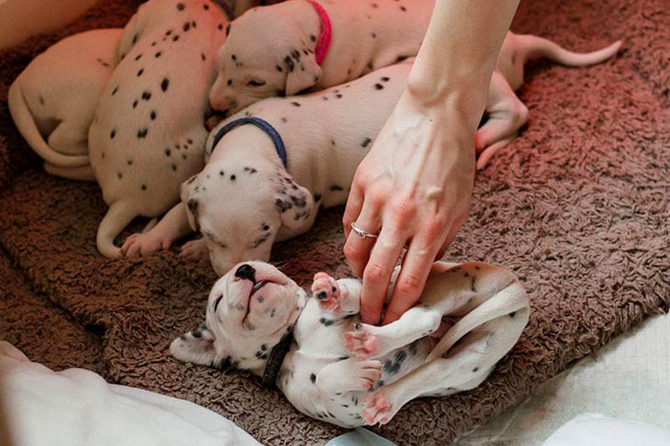
Artificial selection
When humans use the concept of natural selection and control alleles in a population through selective breeding.
  Example: Dog breeding

Slide 25
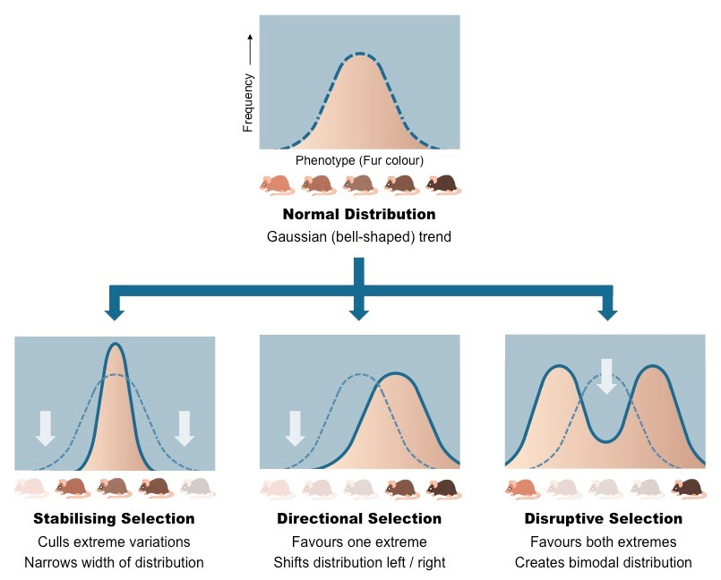
Types of selection
Directional Selection - Changes in allele frequency occur in one direction ex. Turkey breast size
Stabilizing selection – population alleles favor the intermediate result rather than the extremes. Ex. Birth weight
Disruptive selection - When both extremes are favored and the intermediate is diminished. Ex. Fish and territory vs. sneaky mating strategies.

Slide 26
Bell work review
Shoulder partner rally robin/conversation buddy –
  Review the life and observations of Charles Darwin
  Review the theory of Natural Selection and the requirements
  Review the 4 causes of evolution and give an example of each.
  Review the vocabulary words concerning evolution

Slide 27
Evidences of Evolution
Fossil Record
Biogeography
Comparative Anatomy and Embryology
Molecular Biology
Laboratory and field studies

Slide 28
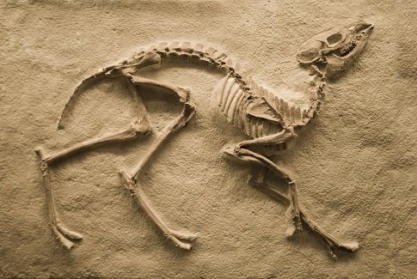
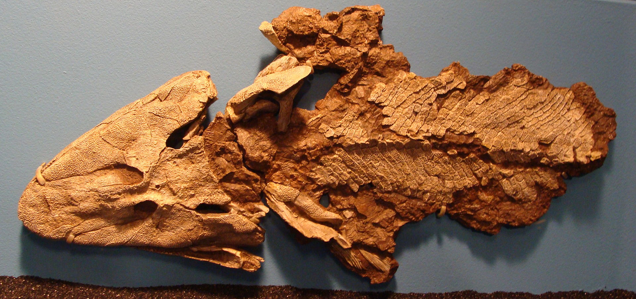
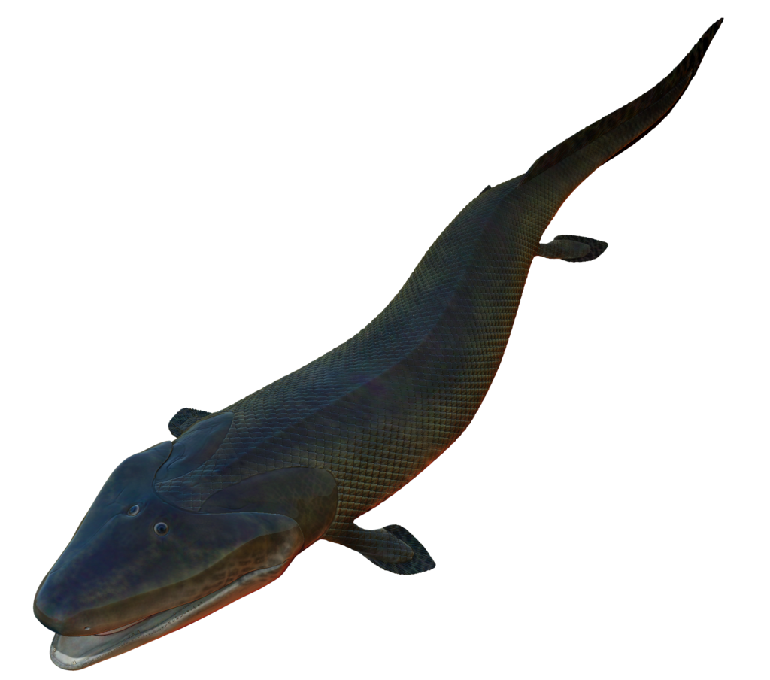
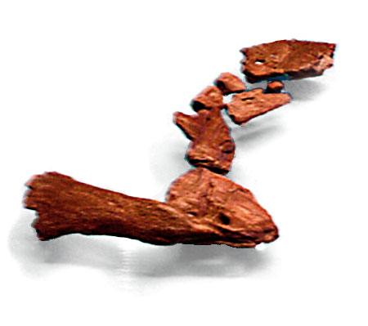
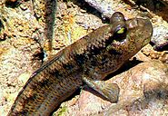
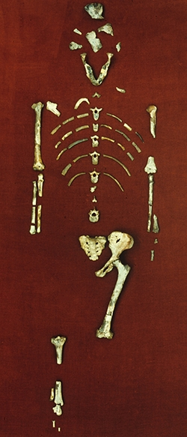
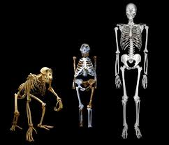
Fossil record
Physical evidence:
  Mineralization of bone, turning it to rock (bones, teeth, shells)
Fossils are found in
  Bottoms of ancient lakes
  Tar pits
  Tree resin
Incomplete – not all organisms are fossilized.
  Scientists are always looking for the “missing links” showing how species could be connected.
    Examples: Tiktaalik and Lucy

Slide 29
Radiometric dating
Dating fossils – Determining the age
  Uranium 238 – used for inorganic matter like rocks (Abiotic factors)
    Half life 4.5 billion years
    Using this, scientists estimate the Earth to be 4.6 billion years old.
  Carbon 14 - used for organic matter like bones that are not yet fossilized (biotic factors
    Half life 5730 years
    https://pubs.usgs.gov/gip/geotime/radiometric.html
    https://www.acs.org/content/acs/en/education/whatischemistry/landmarks/radiocarbon-dating.html

Slide 30
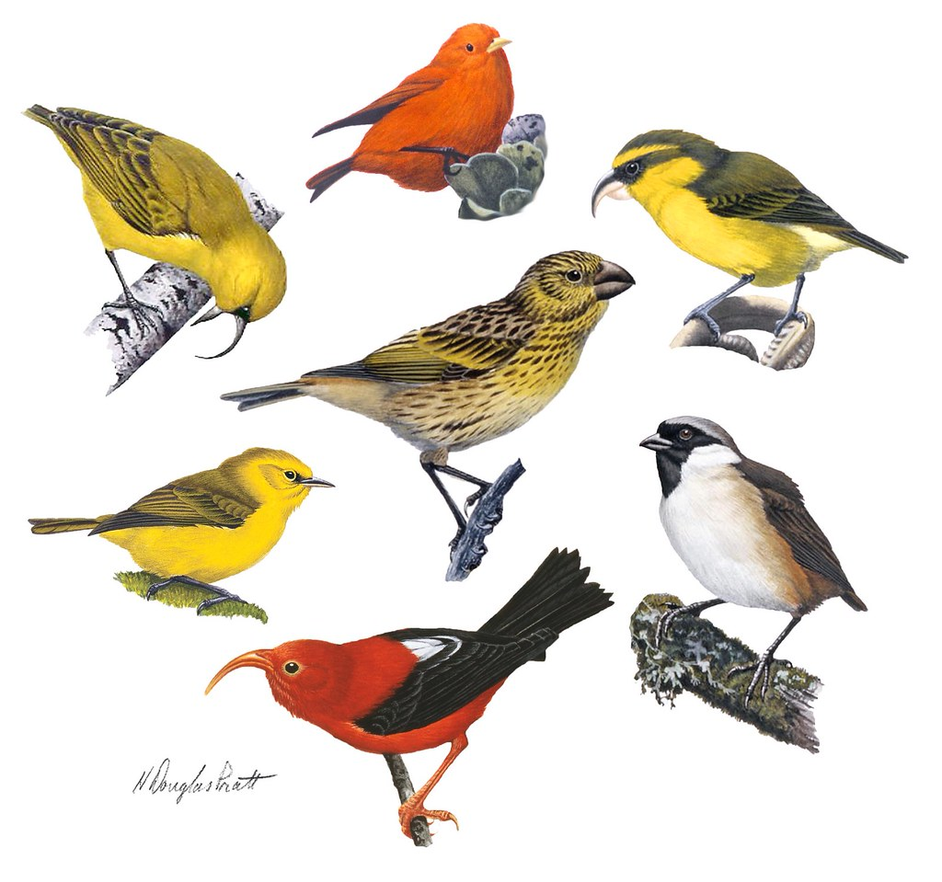
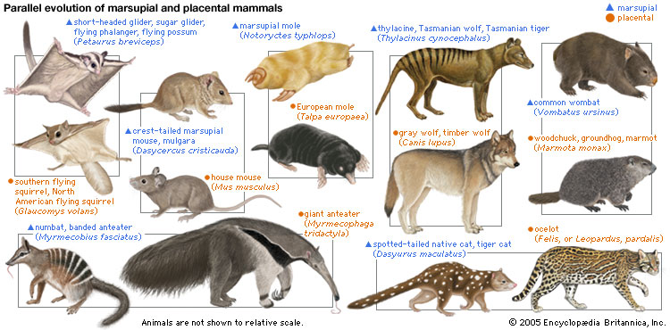
Biogeography
Where organisms live
  Darwin’s Finches on the Galapagos Islands
  Another example: Hawaiian Honeycreeper
    Hawaiian Honeycreeper finch arrived at the Hawaiian Islands. Mutations over time allowed for natural selection based on environment.
    Marsupials of Australia have almost all of the same roles as placental mammals elsewhere.

Slide 31
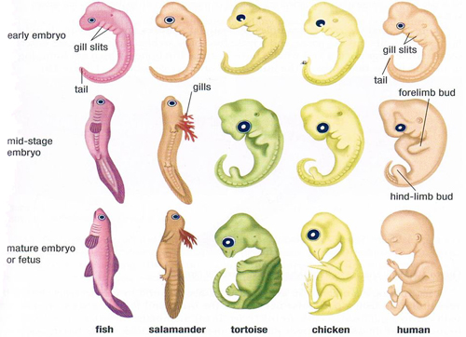
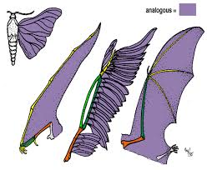
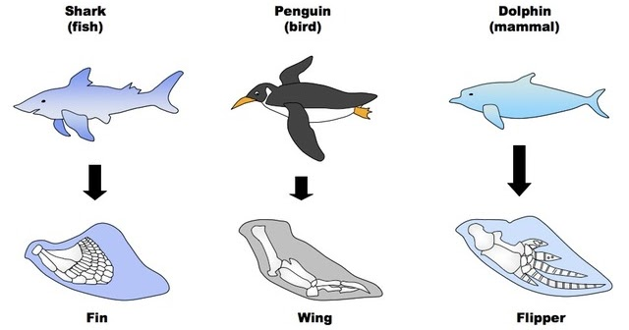
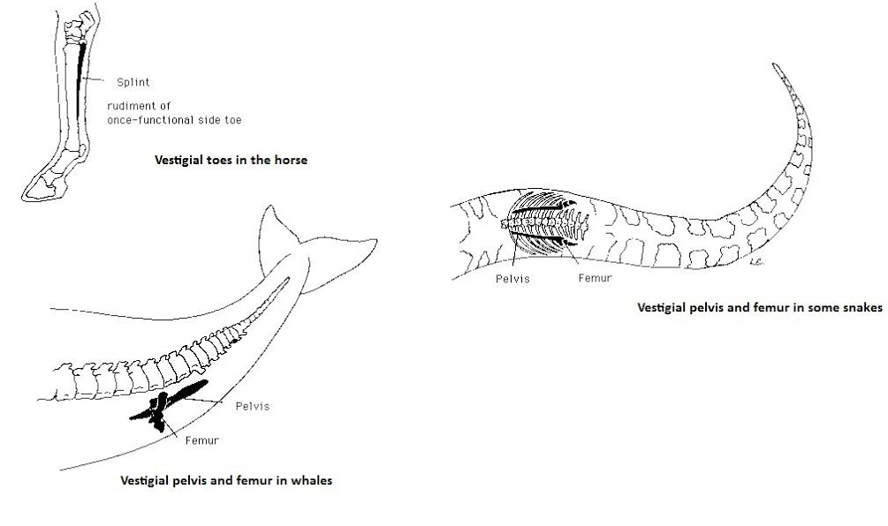
Comparative Anatomy and Embryology – the study of structure and development.
Homologous structures – Structures that look alike but are used differently. Suggests divergent evolution
  Bones of the upper arm/ forelimb
  Tails and gill slits in embryos
Analogous structures – Structures that look different, but are used in a similar way. Suggests convergent evolution
  Wings of birds and wings of butterflies
Vestigial structures – Structures that are no longer used.
  Molars in vampire bats that have a liquid diet
  Eye sockets in cave dwelling fish with no eyes.

Slide 32
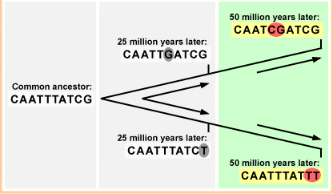
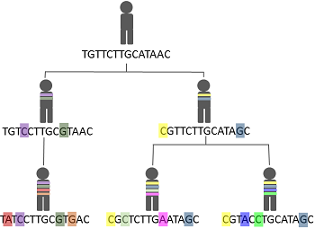
Molecular Biology
DNA – All organisms use the same 4 bases.
Molecular Clock or Evolutionary Clock
  The longer two species have been evolving on their own, the greater the number of genetic differences that accumulate.

Slide 33
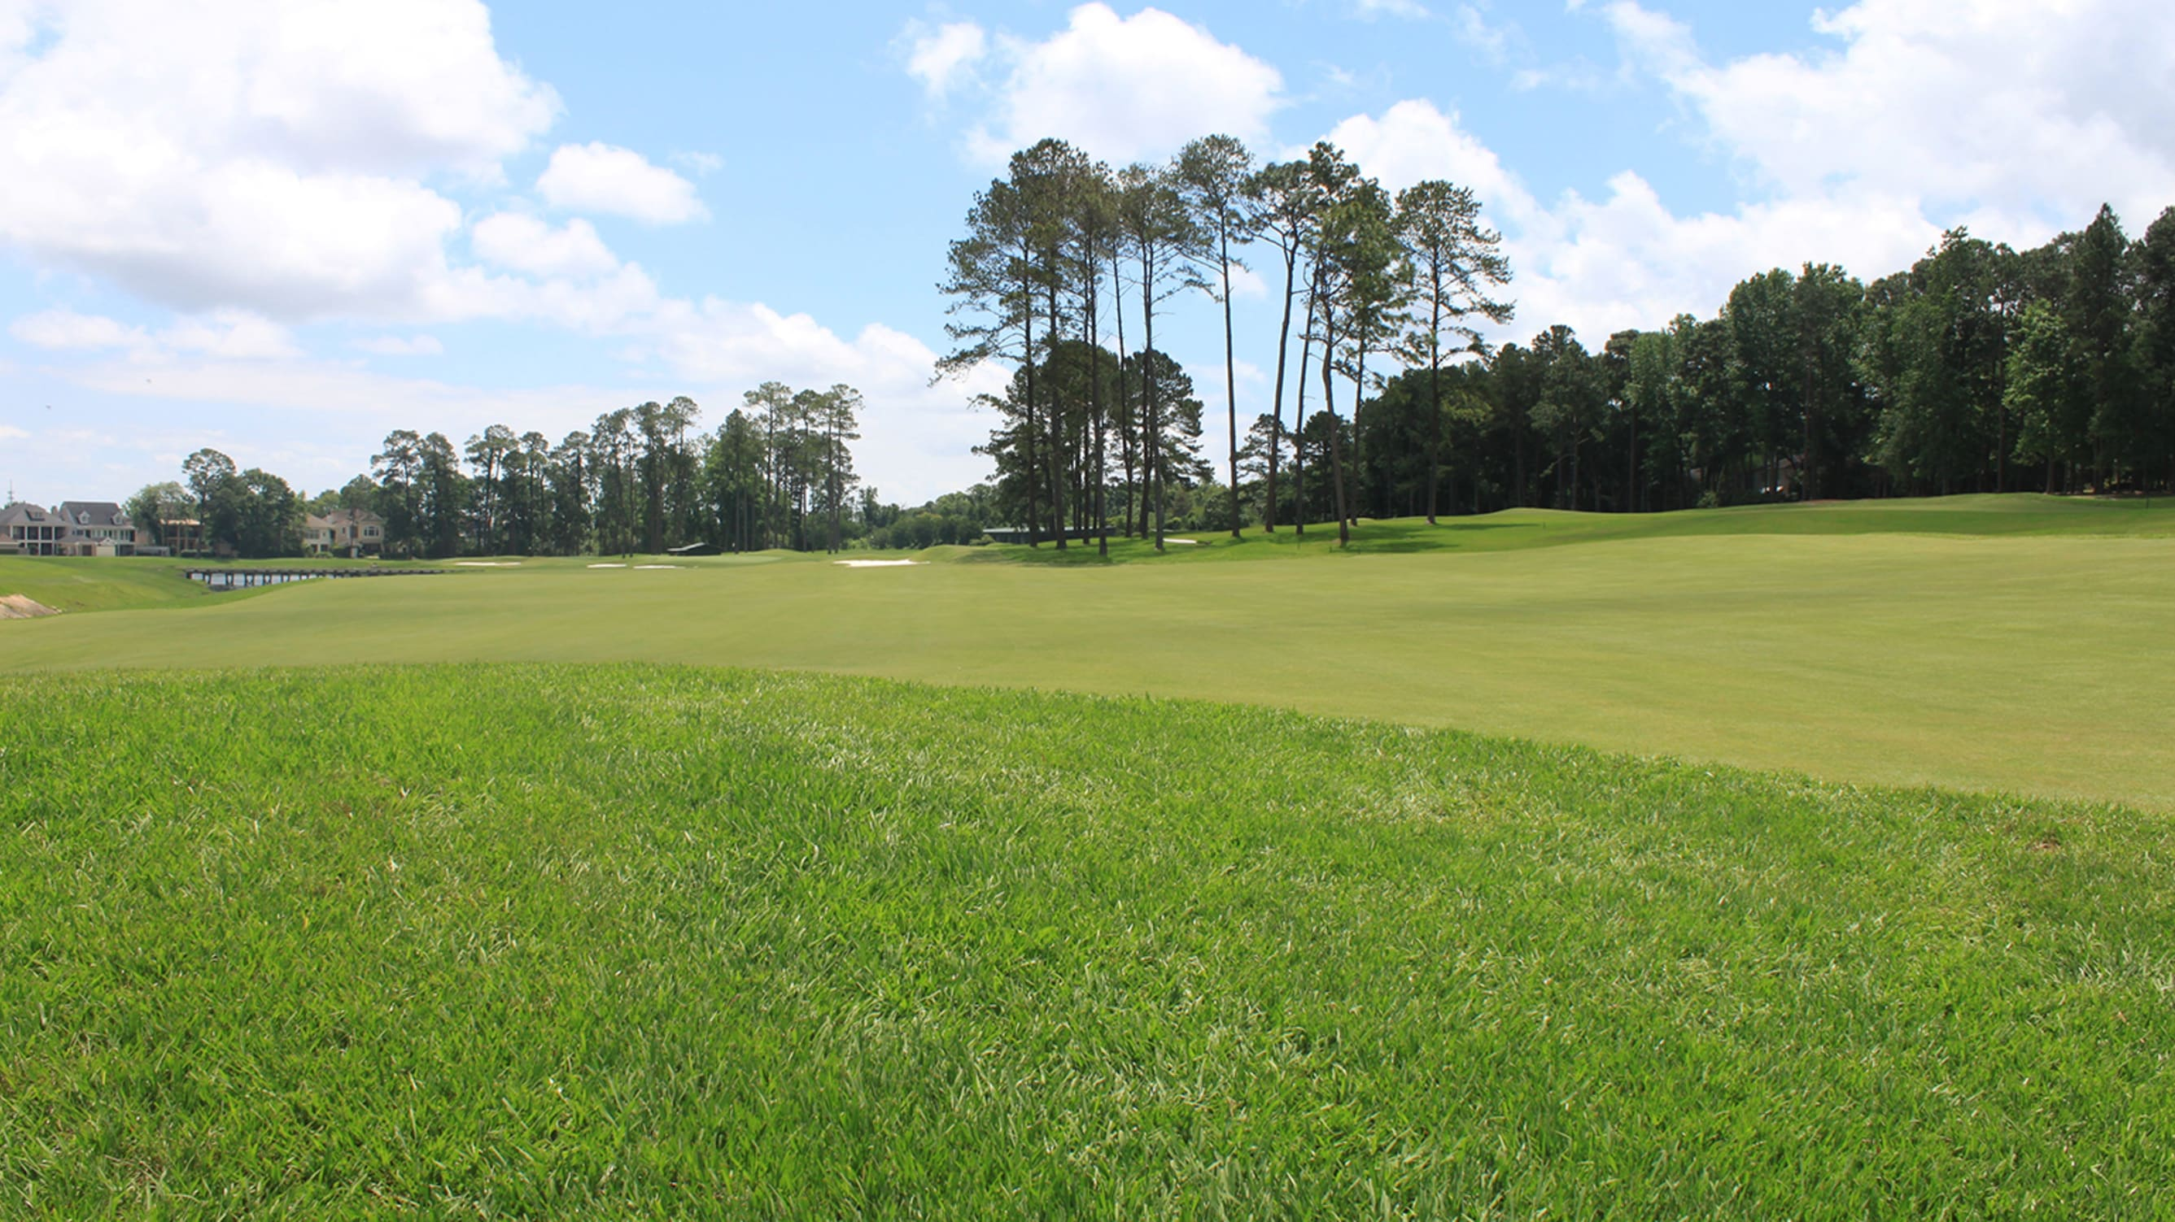
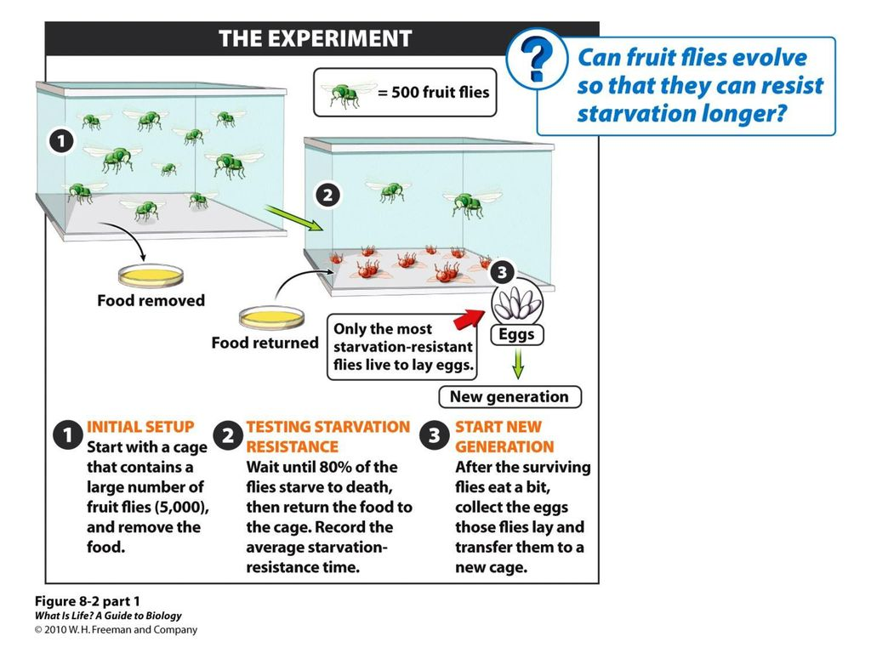
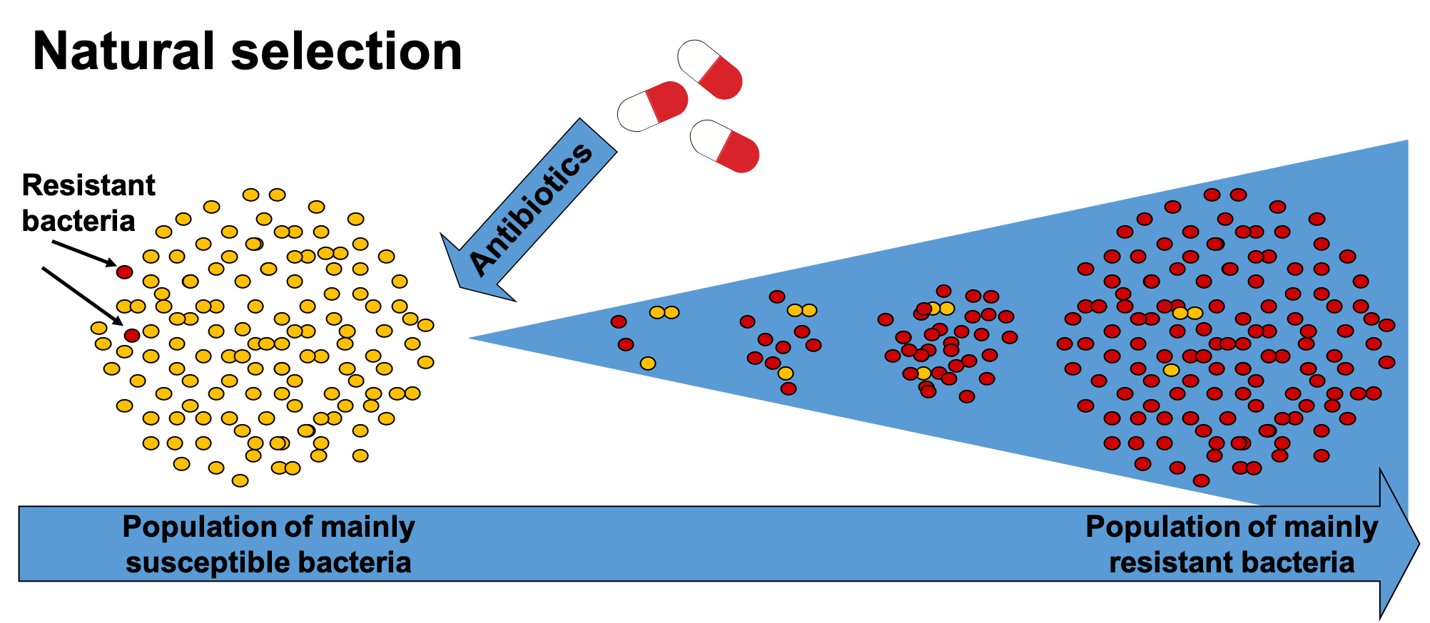
Laboratory and Field Studies
Watching evolution occur over multiple generations through observation in the lab or out in the field.
  Fruit fly starvation resistance
  Golf Grass reproduction with constant pressure to be cut short.
  Antibiotic resistant strains of bacteria.

Slide 34
E-cybermission corrections
Check your sources sections. The first sources section should be a list of your sources. The second section should be your list of sources and all the information that you learned from each source. If you listed 10 sources, they should all have an entry for items you learned from them: For example one of your 10 sources might look like this:
  https://www.youtube.com/watch?v=1WS712DHfmg Life Begins: Crash Course Big History #4
    The origin of life on Earth is not fully known, but there are scientific evidences that support theories that explain how life first arrived. Deep sea thermal vents could support the needs of prokaryotes. The oxygen holocaust killed off many prokaryotes that could not survive in a 3% oxygen environments creating a population bottleneck. All living organisms have DNA therefore we must all be related to each other. There are many theories as to how life arrived on Earth including deep sea thermal vents, and panspermia. Sexual reproduction allows for more genetic variation than binary fission, leading to more diversity of life.

Slide 35
Sources of error
This is not what mistakes did you make when conducting your experiment. ( You should include these in your discussion, but they are not the main focus here). These are the items that you were not able to control that could have altered your results.
  Contamination, wind, temperature fluctuations in an outdoor experiment, amount of resources available to the organism being observed – did the organism leave due to your treatment, or did they run out of resources? Spray bottle squirt consistency – do they spray the same amount every time? Think of all the possible contributors to a result, and if some were out of your control, these should be listed under your sources of error.

Slide 36
Please e-mail me when you have made all revisions and are ready to submit.

Slide 37
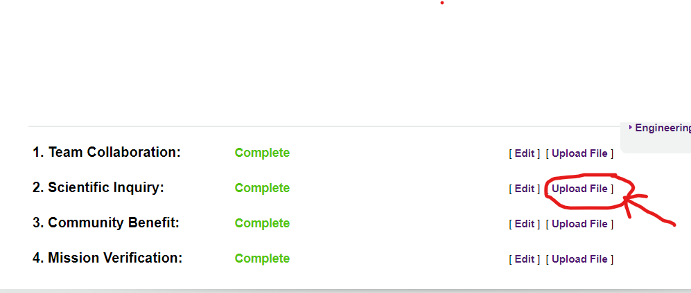
Check your E-cybermission for your graphs, charts and picture uploads.
Click the upload file link to attach your graphs, charts and photos.

Slide 38
Review with your shoulder partner
5 evidences of Evolution
  Fossil record – What are they? where are they found? How do we date them?
  Biogeography - examples
  Comparative anatomy and embryology
    Homologous structures – examples
    Analogous structures – examples
    Vestigial structures – examples
  Molecular Biology – Molecular clock
  Laboratory and field studies - examples

Slide 39


Slide 40


Slide 41
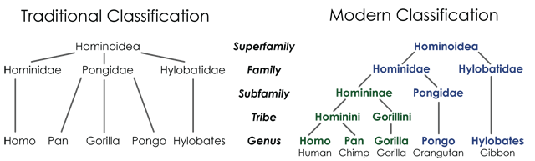

Slide 42
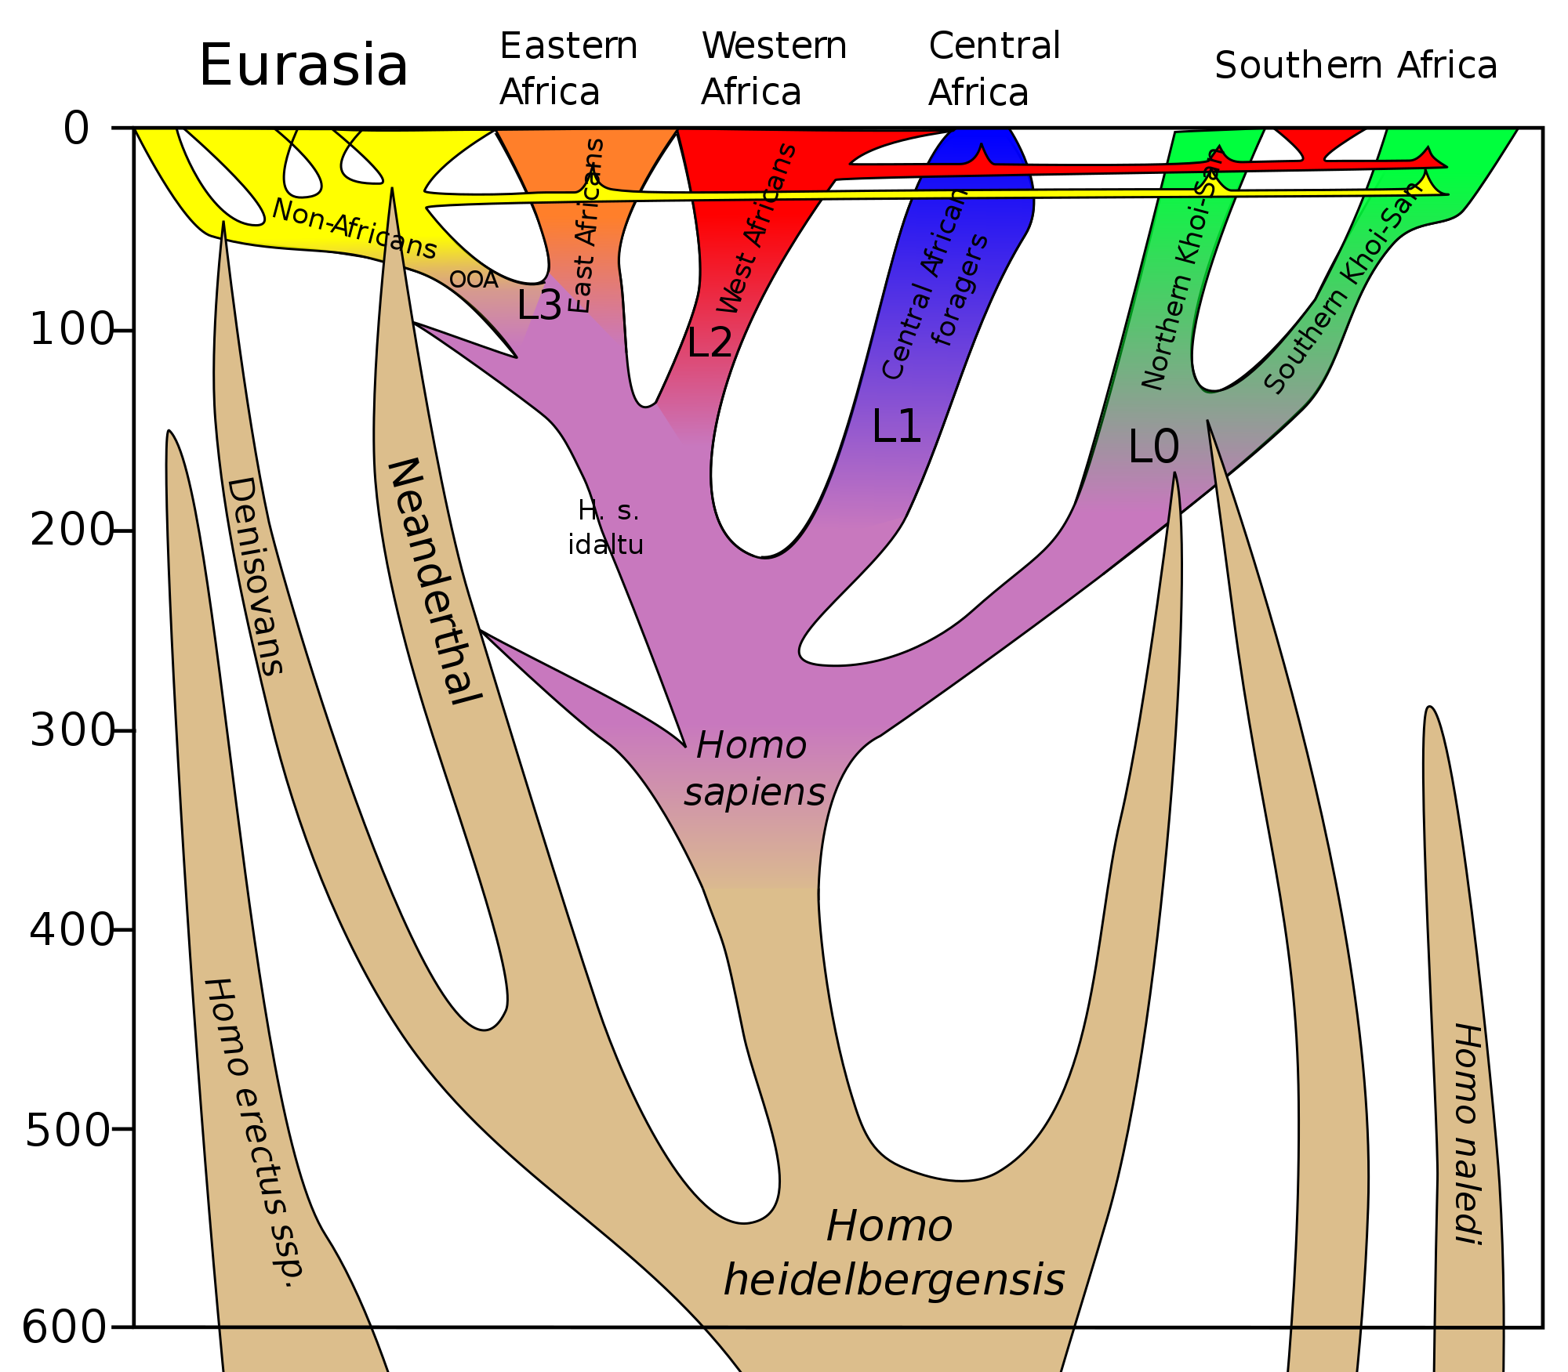

Slide 43
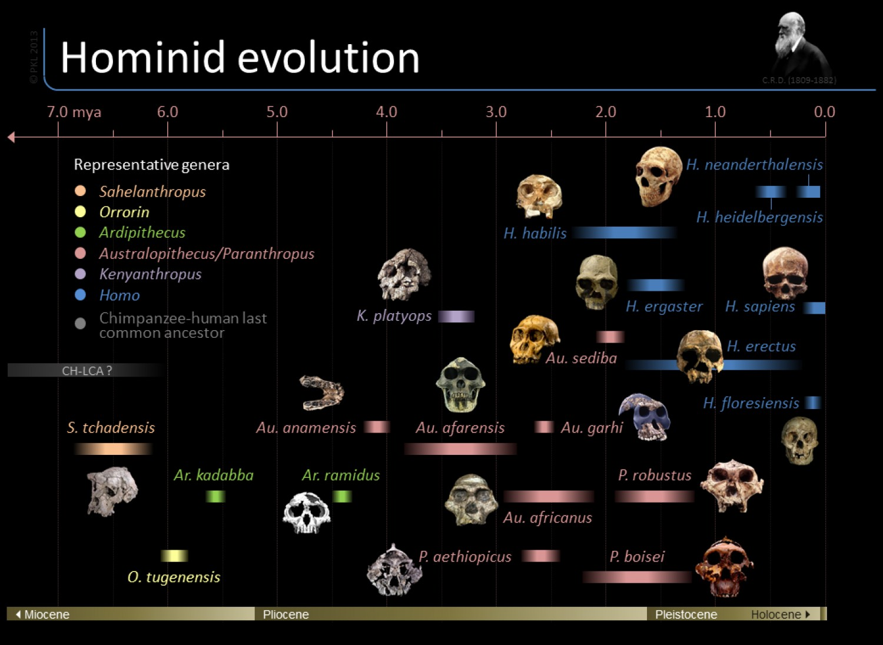

Slide 44
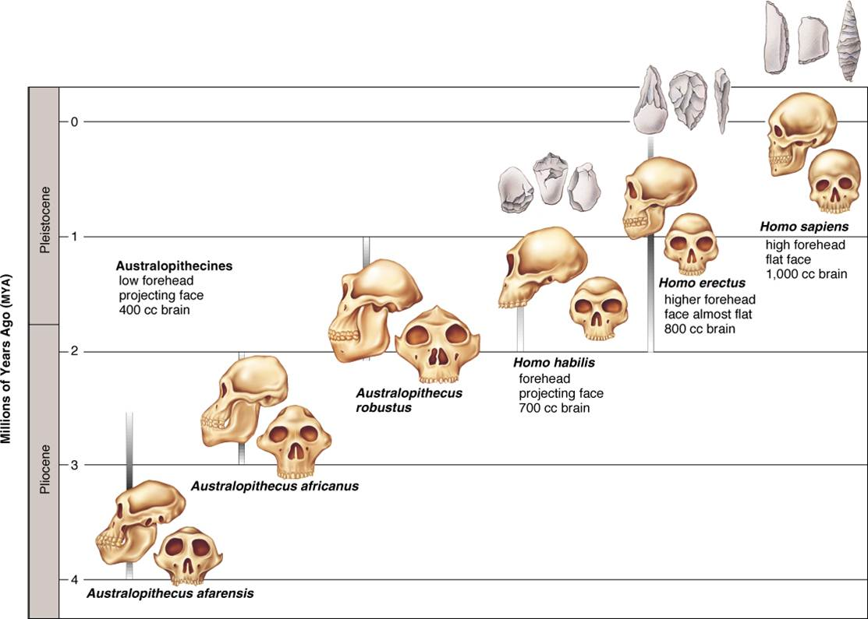
LEQ: How does brain size, jaw size, language, and use of tools show evidence for trends in hominid evolution?
Observe skulls, jaws and skeletal variations
Compare/contrast modern humans with their hominid ancestors.
Terms- prehensile tail, bipedal, hominid

Slide 45
