Slide 1
How to take great notes for any class.
Make your notes work for you!

Slide 2
Jim Kwik and taking notes

Slide 3
Note taking styles are as different as we are.
Notetaking should be a personal experience. Your notes need to make sense to you.
KWL
Mind maps
Cornell Notes
Capture and Create

Slide 4
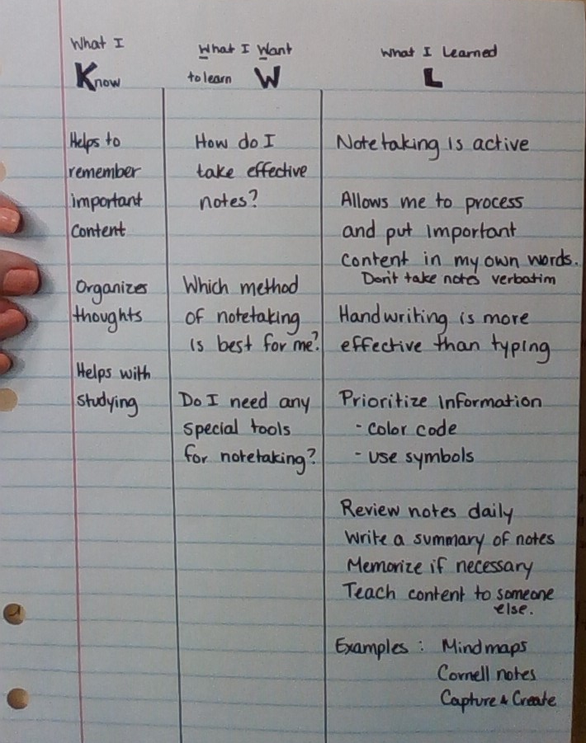
KWL strategy
K – What you know. List all the pieces of information about the topic being covered that you already know.
W – What you want to know. Write down key words or questions that prompt you to learn new information.
L – What you have learned. Write down new information that is revealed in the reading or lecture. If you are able to, answer your questions from the W section.

Slide 5
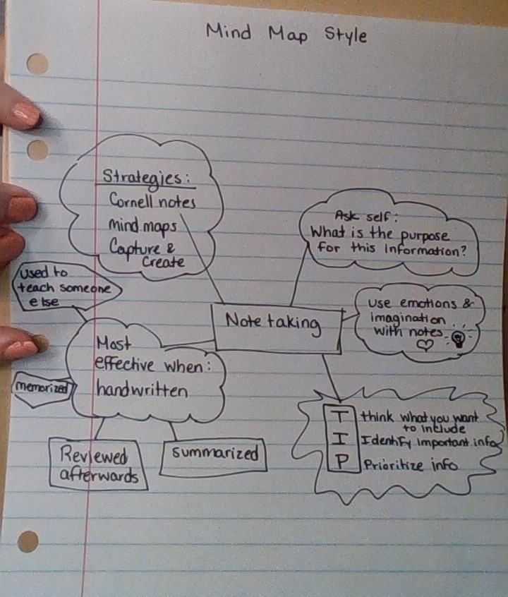
Mind Map Strategy
Mind maps are a visual strategy for organizing concepts covered in reading or lecture.
Start with the title. Connect related concepts or information together.
Very useful if you are a visual learner or like to draw in your notes.
Format is up to the notetaker.

Slide 6
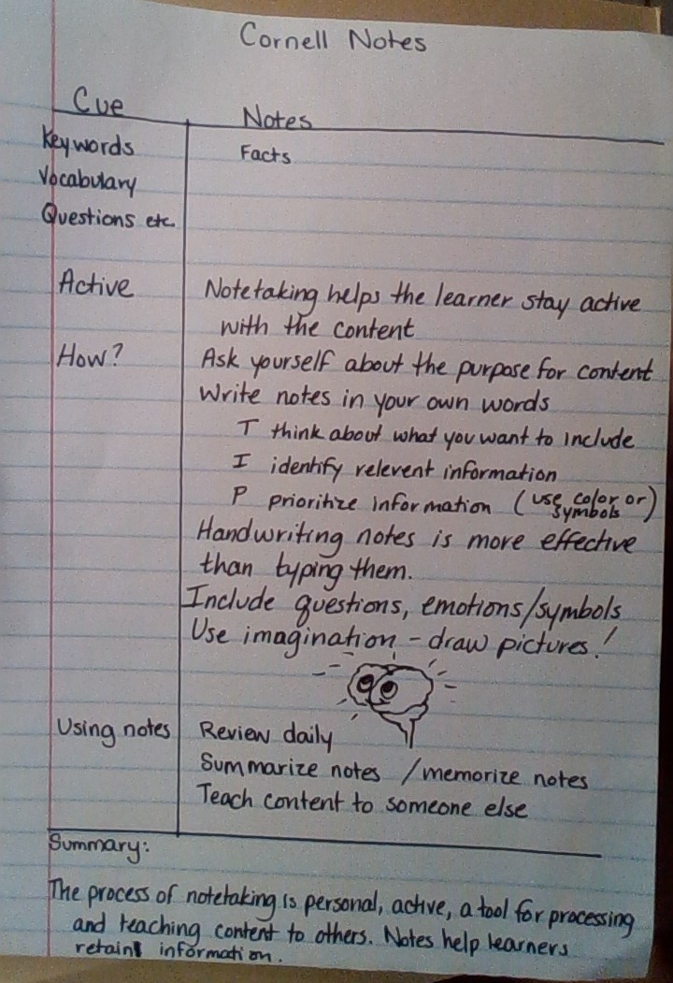
Cornell Notes strategy
Developed at Cornell University
Cue column is for key words, questions, or main concept titles.
Content column is for the information learned in the reading or lecture that corresponds with the item in the cue column.
Summary – The most powerful part of Cornell Notes is the chance to summarize content and put it in your own words.

Slide 7
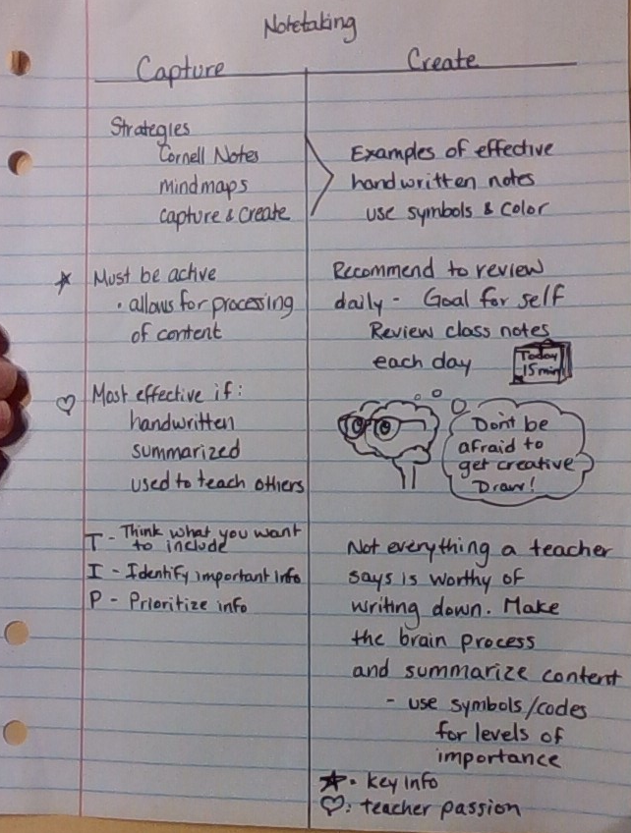
Capture and create Strategy
Capture column is for writing important information from the reading or lecture. Vocabulary, mnemonics, examples, facts, etc.
Create column is for asking questions, summarizing, drawing pictures, creating additional examples, drawing connections with previously learned content, etc.

Slide 8
How to use your notes
Whatever style of notes you choose or are instructed to use, your work is not done by just writing them.
What does it mean to “study your notes”?
Review your notes at the end of the day for each of your courses.
Read through what you wrote and tell yourself about the content you learned that day.
Teach the content that you learned to someone else.
Write down any additional questions that you come up with after processing your notes to ask the teacher in your next session.
Some notes are also meant to be memorized. You may need to employ some additional techniques like: Repetition, body movements, mnemonics, use of notecards, etc.

Slide 9
What style is best?
Teachers may model the best strategy that works for most students for the topic being covered.
If not specifically modeled by the teacher, you get to choose what works for you.
If you are linear thinking, logical, like things in columns and boxes, etc.
KWL if you like to activate prior knowledge and challenge yourself to see what you know before covering content.
Cornell if you have limited background knowledge and want the built in processing of the summary section
If you are a creative thinker, like color and pictures, etc.
Mind maps for stream of conscious note taking and visually connecting concepts.
Capture and create is a great meld of both linear/logical and creative.

Slide 10
Why is this important?
Through your elementary and middle school years, you have been learning to take notes through writing in journals, composition notebooks, and using interactive notebooks designed by your teacher. In college, you may take courses where the instructor does not provide notes, and you will be expected to take notes during lecture.
High school is an excellent time to understand your preferred learning style, and find what is most efficient for you.
You will see some notes modelled in class that you transcribe to your notebooks.
You will see some content delivered to you in other formats like videos, PowerPoints, and games that you will need to choose how to document that content for your studies.

