Slide 1
Human Body
4 systems
Reproductive, Cardiovascular, Immune, Nervous

Slide 2
SC.912.L.16.13 Describe the basic anatomy and physiology of the human reproductive system. Describe the process of human development from fertilization to birth and major changes that occur in each trimester of pregnancy.
Warning: Do not do internet research on this topic without my guidance/instruction. Doing so may lead you to inappropriate websites and may result in disciplinary action.

Slide 3
Vocabulary
Sperm- Male gamete
Ovum – Female gamete
Zygote – Fertilized egg
Fertilization – combining of male and female gametes (fusion of DNA)
Oviparity (oviparous) – Use of laying eggs that hatch outside the body. Embryonic development occurs outside the body in an egg. Ex. Chickens
Viviparity (viviparous) – Characteristic of giving live birth. Embryonic development occurs inside the body. Ex. Humans
Ovoviviparity (ovoviviparous) – Use of eggs for hatching, but the embryonic development occurs inside the body. Ex. Sharks

Slide 4
Male Reproductive system structures
Seminal Vesicle – provides sperm with nutrients
Prostate Gland- provides sperm with a milky base (pH), enzymes and nutrients
Bladder
Bulbourethral Gland – produces mucus for lubrication and provides sperm with sugars.
Vas deferens
Urethra
Sperm are produced inside seminiferous tubules, inside the testis
Epididymis – storage and maturation location for sperm
Scrotum – Sac-like structure that regulates the internal temperature of the testis for sperm production.
Penis

Slide 5
1. Sperm are produced through meiosis (spermatogenesis) in the seminiferous tubules. Once produced, sperm are sent to the epididymis to mature.
2. If gametes are needed (ejaculation), they travel up the vas deferens around the bladder and pick up nutrients and fluids that make semen from the seminal vesicle, prostate and bulbourethral glands.
3. Semen is expelled through the urethra (same tube for removal of urine) during ejaculation. Contains approximately 300 million sperm.

Slide 6
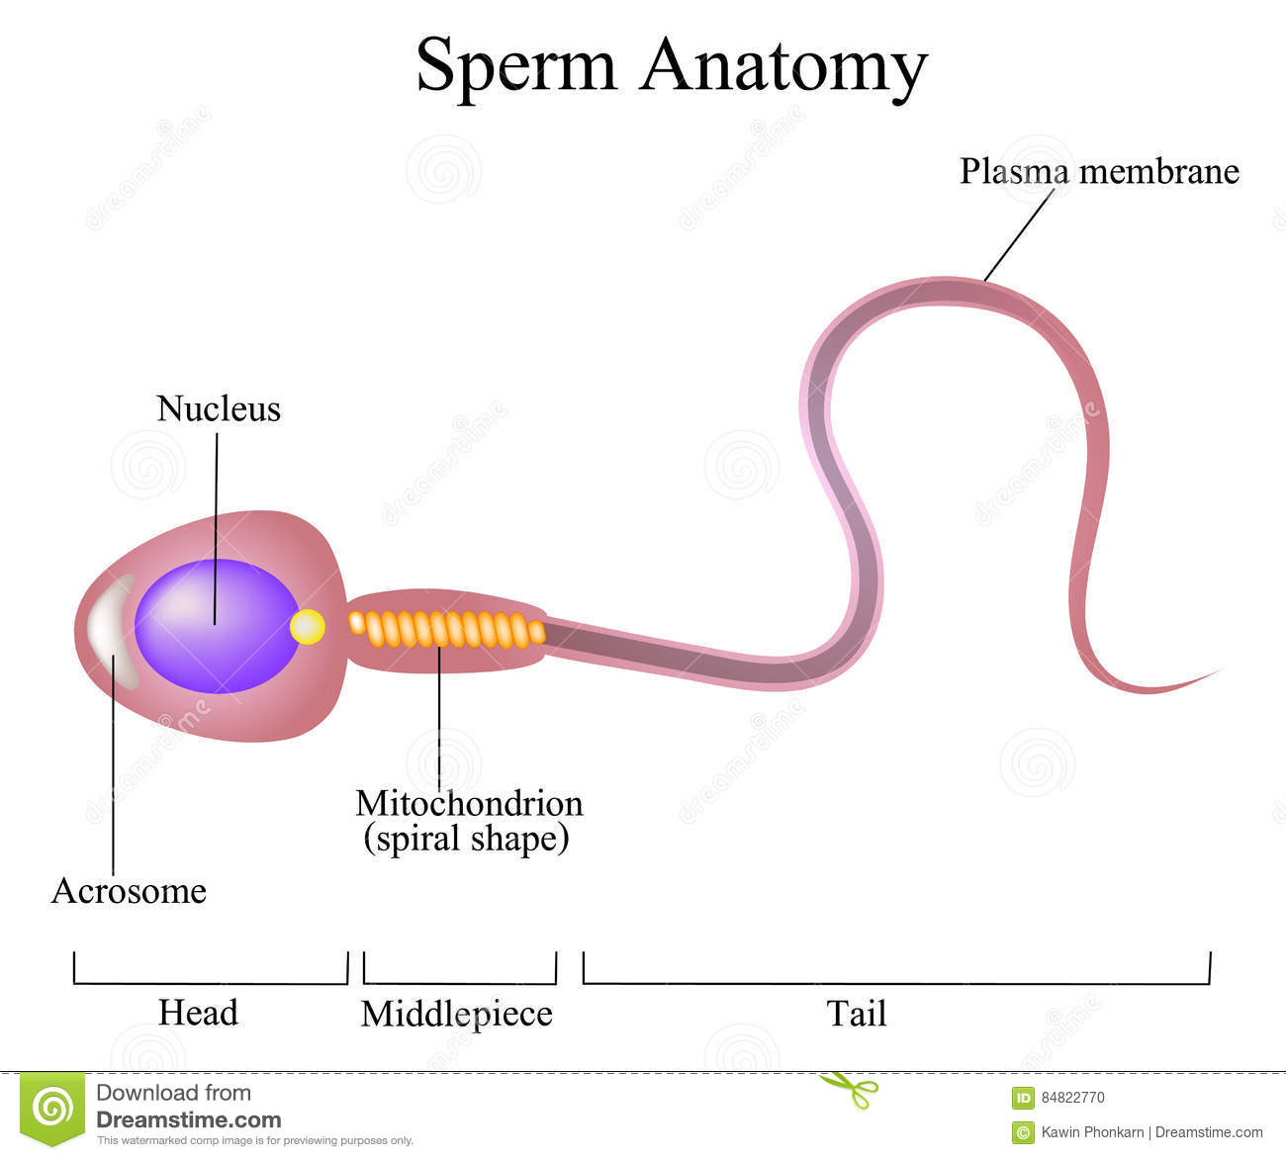
The acrosome contains enzymes which help to break down the outside layers of the egg (ovum).

Slide 7
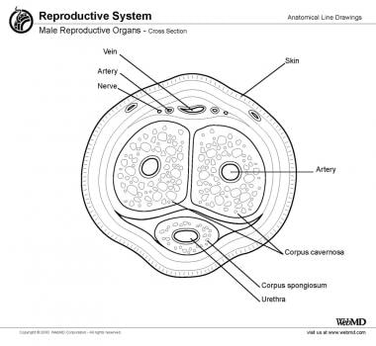
Physiology: How does an erection work?
Erection occurs from arteries that dilate (get larger in circumference) and leak fluid into the spongy tissue surrounding them. This increase in fluid pressure closes off the veins that allows blood to exit the penis. This keeps the penis rigid.

Slide 8
Female Reproductive System Structures
Oviducts/Fallopian tubes
Uterus
Endometrium/ Endometrial lining
Cervix
Ovary
Vagina

Slide 9
Side view
Cervix
Ovary
Oviduct
Uterus
Labia minora
Labia majora
Vagina

Slide 10
Path of the Ovum/ description of anatomy
1. The ovary is the site of oogenesis. Oogenesis begins in fetal development but ceases at Prophase 1 until puberty. By the time a female is born, she has a limited number of potential eggs.
2. Once an ovum is matured, it leaves the ovary and is picked up by the oviduct (fallopian tubes). The oviduct is the optimum site for fertilization to occur.
3. The ovum travels to the uterus. If fertilized it implants in the endometrium.
4. The cervix is the entry/exit of the uterus.
5. The vagina is a stretchy tube that connects the exterior of the body to the cervix/uterus.
6. Labia minora is the pair of inner skin folds covering the genitals
7. Labia majora is the pair of thick outer skin and fat folds for protection.

Slide 11
Ovulation typically results in one oocyte (ovum) being released.
If 2 or more ova are released, then there is potential for fraternal twins (twins that are not identical)
If a single egg splits during mitosis after fertilization and continues mitosis as two eggs, this results in identical twins.

Slide 12
Steps in the ovarian/menstrual cycles
Menstruation – the first day of menstruation (period) begins a new menstrual cycle. Menstruation continues for 3-5 days. The endometrial lining is shed in response to a significant drop in estrogen production.
Decreased estrogen triggers and increase in follicle stimulating hormone (FSH) from the pituitary gland.
FSH causes a few follicles to develop within the ovary, one reaches maturity and completes Meiosis
Developing follicles produce estrogen.
High levels of estrogen trigger the release of luteinizing hormone (LH) and more FSH

Slide 13
Continued:
Ovulation occurs due to the increase in LH and FSH approximately 14 days after the start of the menstrual cycle.
Progesterone is released by the corpus luteum (cells left behind in the ovary that were surrounding the ovum as it matured) in the ovary.
Pro=for
Gestare= to bear
Endometrium thickens in preparation for implantation of a zygote/embryo.
Endometrium supplies the embryo with glycogen and access to blood until the umbilical cord forms.
If not fertilized, the ovum degrades and the corpus luteum degrades causing a drop in estrogen and progesterone. Triggers menstruation.

Slide 14
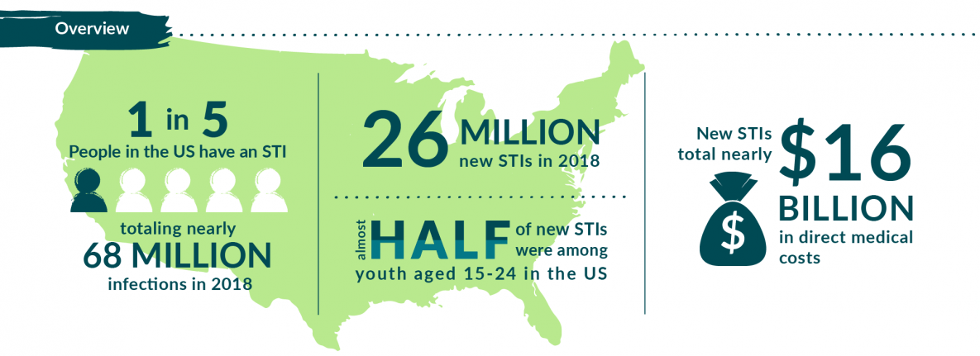
Sexually Transmitted Diseases/Infections (STDs/STIs)

Slide 15
Bacterial infections transmitted through vaginal, oral or anal sex – usually treatable if discovered early with antibiotics.
Gonorrhea – Symptoms may or may not show within 2-28 days after sexual contact. Includes: Painful urination, genital discharge, irregular menstruation. This bacteria may become untreatable in the near future due to antibiotic resistance.
Syphilis – Symptoms may not appear for years, sores, skin rash, and organ damage. Treatable if caught early.
Chlamydia – Often no symptoms, sometimes painful urination, genital discharge.

Slide 16
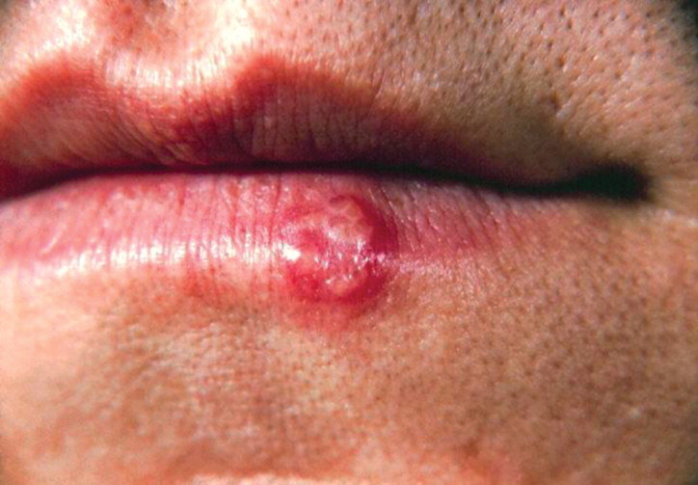
Viral Infections ( No cure for these) Once received, you have it for the rest of your life.
HIV/AIDS- initial symptoms range form none to flu-like, late stages involve severe infections and death. Antiviral meds to slow progression.
Genital Herpes – Often no symptoms; outbreaks include open sores on the genitals and flu-like symptoms. Antiviral meds can shorten/reduce outbreaks.
Human Papilloma Virus (HPV)- Often none, some types can lead to genital warts, others can cause cervical cancer. Vaccine is available to prevent some strains that can cause cervical cancer.

Slide 17
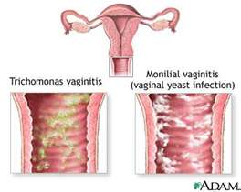
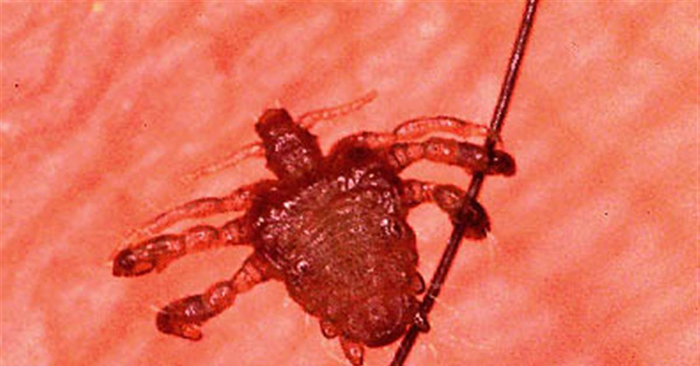
Other types of STDs
Protist – Trichomoniasis – painful urination and/or vaginal discharge in women, often no symptoms in men, may experience burning sensation inside the penis, and have a discharge.
Fungus – Yeast infections – genital itching or burning, and/or vaginal discharge in women; genital itching in men.
Arthropod – Crab lice – Visible lice eggs or lice crawling on or attached to pubic hair, itching in the pubic and groin area.

Slide 18
The only way to guarantee that you won’t get an STD is to not participate in sexual contact.
Abstinence is the only 100 % effective method of STD prevention.
Barrier devices can help to reduce risk if used correctly, but are not 100% effective.

Slide 19
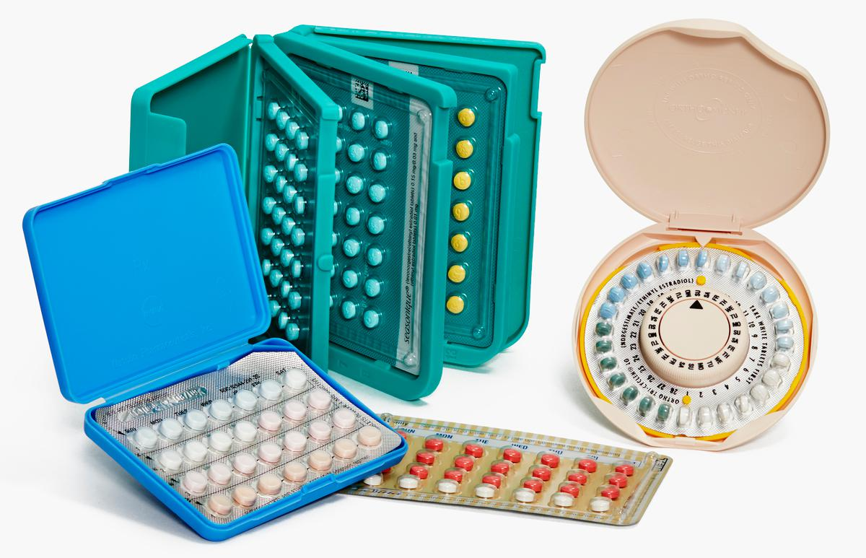
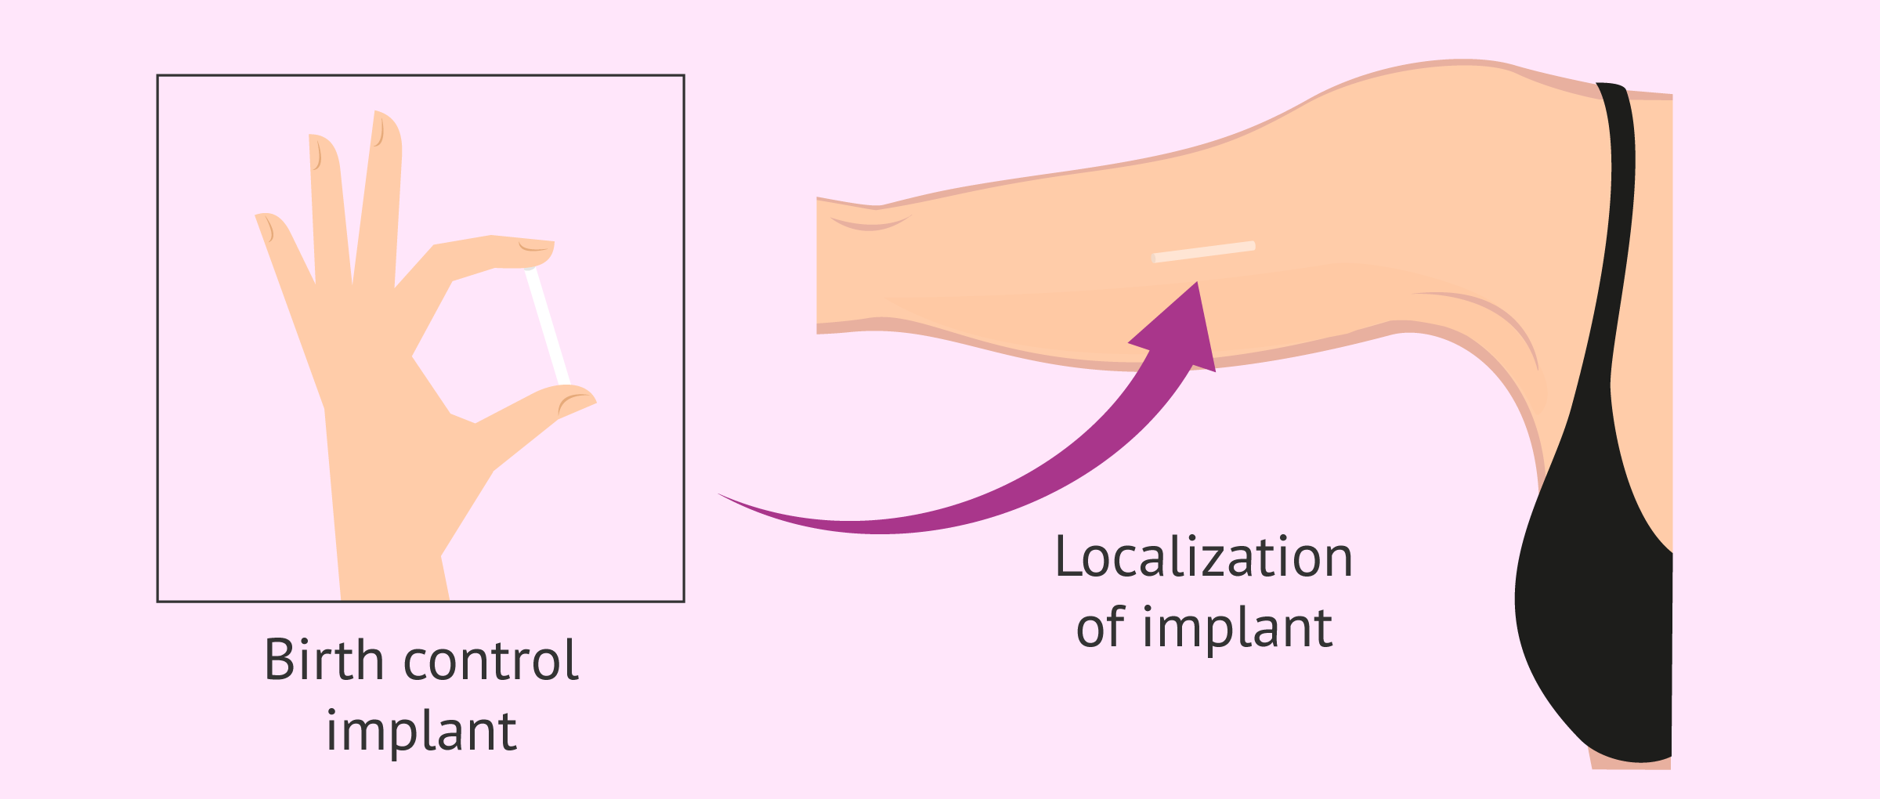
Methods of contraception (preventing pregnancy)
Prevent ovulation:
Birth Control Pills, Hormone injections, Hormone patches or implants 92-99% effective - Synthetic hormones that prevent the release of FSH. Prevents maturing an ovum. No STD protection. Risks: Increased chance of blood clots, especially when combined with nicotine. Read packaging insert for usage instructions and risks.

Slide 20
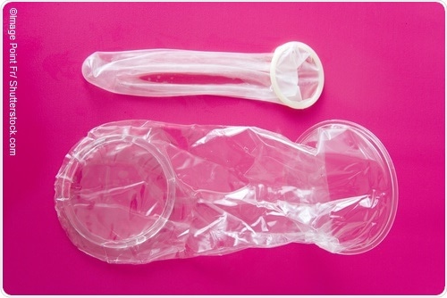
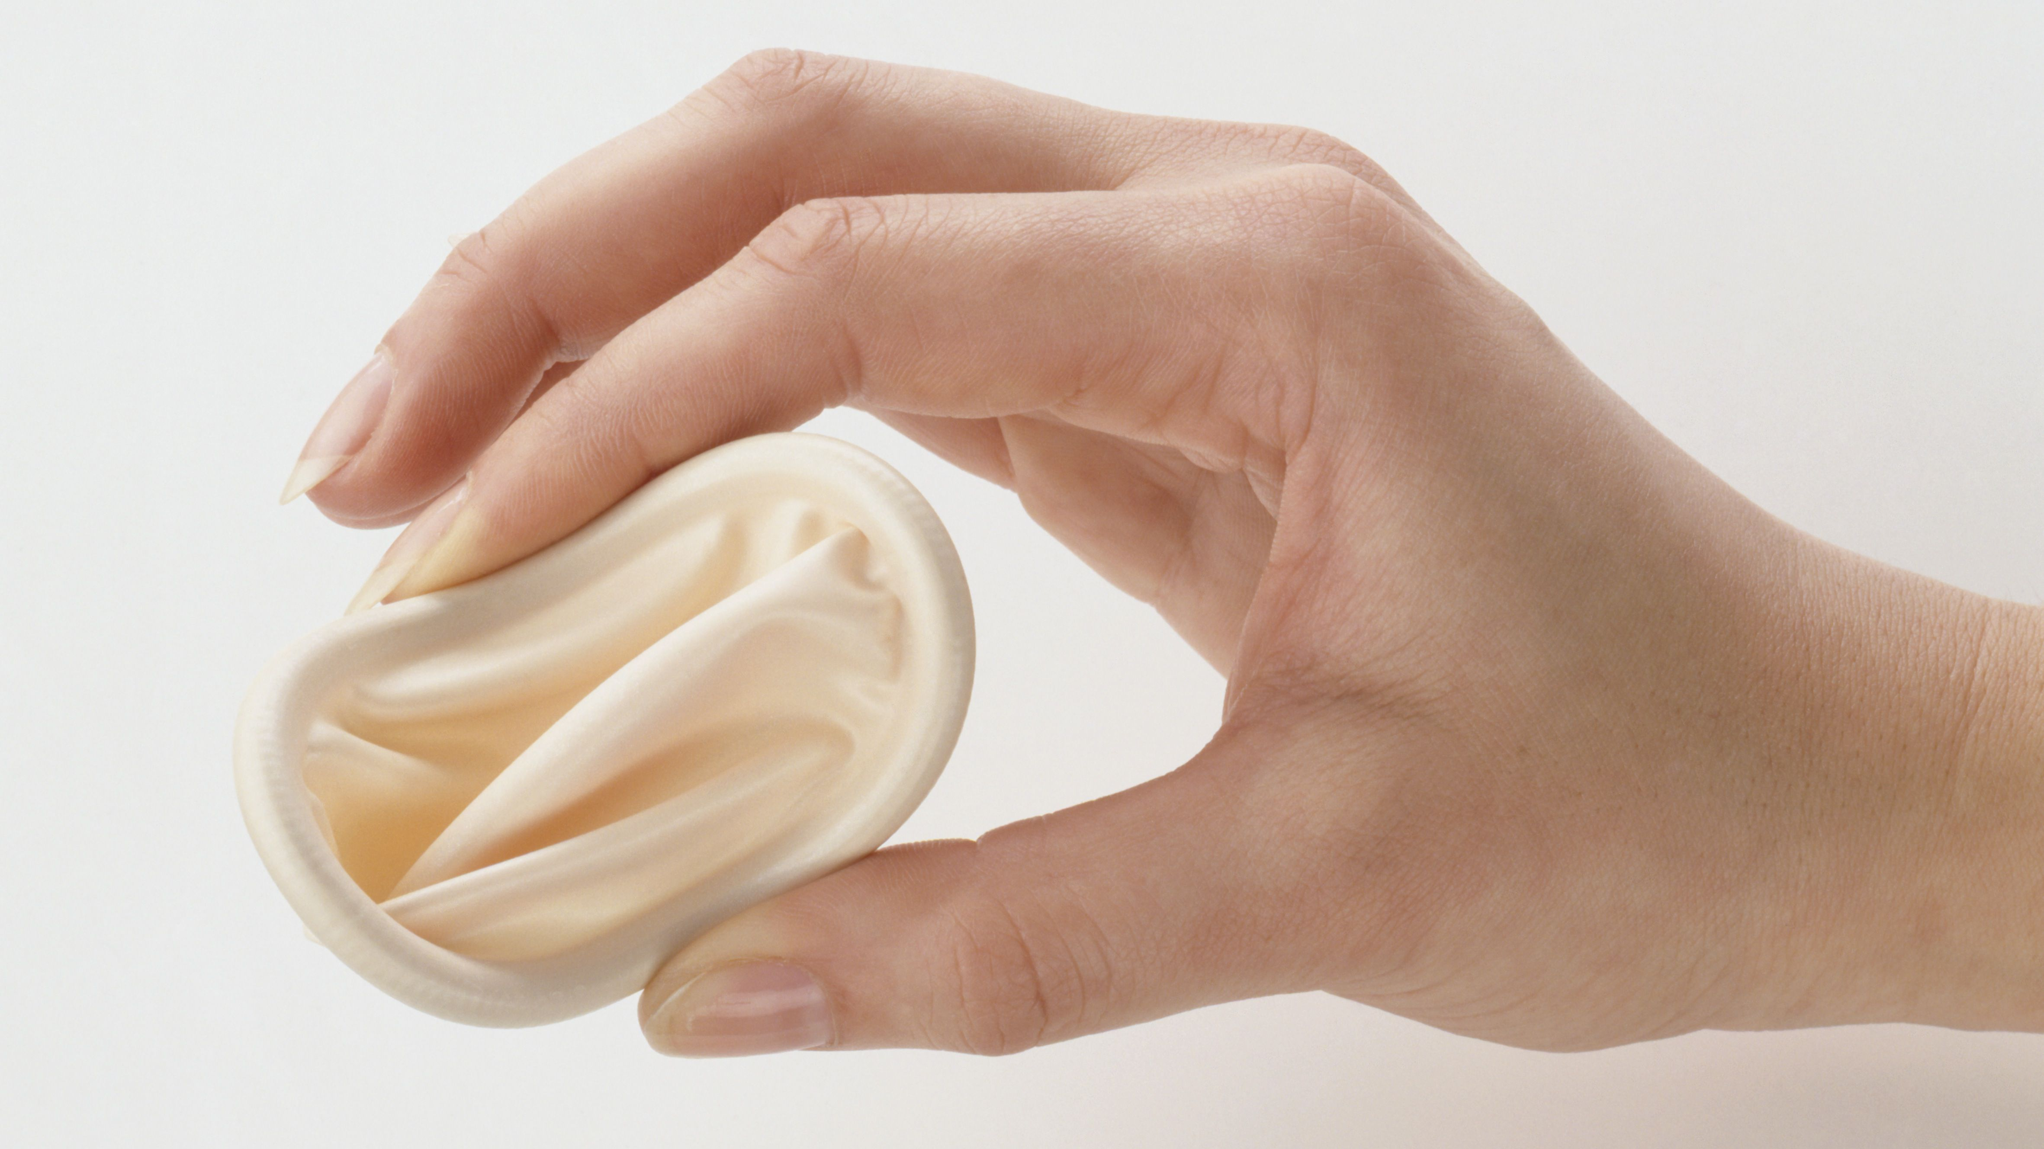
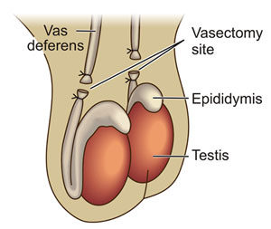
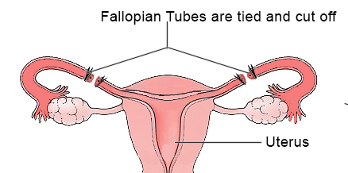
Prevent fertilization
Condoms: Male 85-98% effective /Female 79-95% effective Provides some protection against STDs when used correctly. Risks: allergic skin reactions. Always read instructions and risks on package insert before use.
Diaphragm: A dome-shaped piece of rubber that is inserted into the vagina to cover the cervix. Fitted by a doctor. Blocks sperm from entering the uterus through the cervix. 84-94% effective. No protection against STDs.
Sterilization: Vasectomy/Tubal ligation >99% effective. No protection against STDs.
Abstinence - Refrain from sexual contact. If used all the time, 100% effective against pregnancy and STD’s. If only used during optimal fertilization days ( ovulation) 75-99% effective against pregnancy, and no protection against STDs.

Slide 21
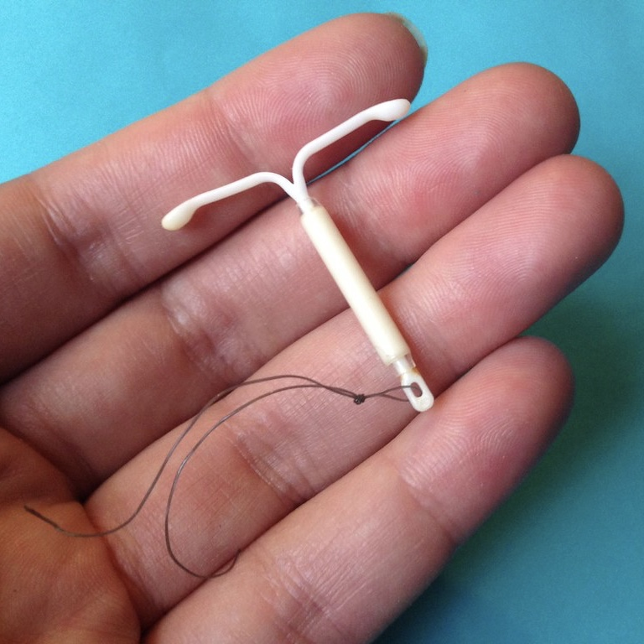
Prevent implantation of fertilized egg
Intrauterine device (IUD) Small plastic or metal device that is inserted into the uterus by a doctor. Tricks the body into thinking that there is already a fetus growing in the uterus, and will not allow a second zygote to attach. >99% effective against pregnancy. No protection against STDs. Risks include scarring and damage to the uterus.
“Morning-After pills” or “ Plan B” A pill containing 50 times the normal dose of estrogen from a birth control pill. Stops ovum development or implantation. Effectiveness 75%. No protection against STDs. Risks include abdominal pain, nausea, headaches, etc. Read all instructions/inserts.
100% Abstinence is the only 100% effective method of preventing both pregnancy and STDs.

Slide 22
Practice Identifying structures and explaining their function.

Slide 23
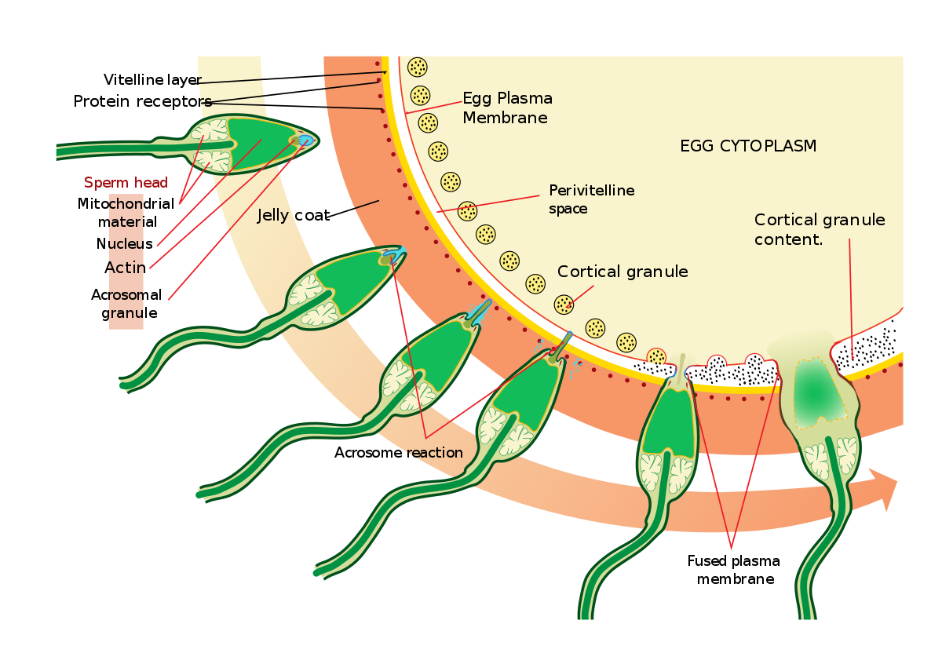
Human Development from fertilization to birth
Fertilization (three stages – penetration, activation, nuclei fusion)
Penetration – the race to see which sperm can get through the follicular cells and zona pellucida first
Activation – the plasma membrane of the sperm’s head fuses with the cell membrane of the egg/ovum. No other sperm will be allowed to fuse.
Nuclear fusion – the nucleus of the sperm and egg fuse to make a diploid cell.

Slide 24
1st Trimester
Cleavage phase – (location: oviduct)
30 hours after fertilization occurs, the fertilized ovum begins mitosis. After 6 days, a blastula/blastocyst is formed. The cells secrete a fluid that collects in the center.
Gastrulation (Location: Uterus/ embedding in endometrial lining)
The squishing and folding of the blastocyst to become 3 layers of cells. The inner mass of cells begins to fold inward creating layers (Week 2)
Endoderm – Becomes internal organs later
Mesoderm – Becomes muscle and skeleton later
Ectoderm – Becomes skin and nervous system later

Slide 25
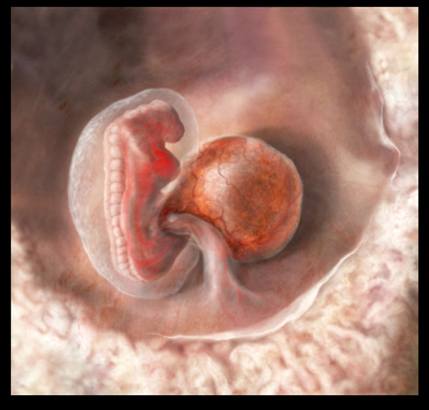
1st Trimester cont.
Neurulation
3 tissue layers continue folding to create structures.
Neural tube is created (future brain and spinal cord)
Coelom becomes internal organs.
Week 4 (Begins Month 2)
Male/female – Gonads begin to develop
Major organs such as eyes and heart begin to form
Arm and leg buds form

Slide 26
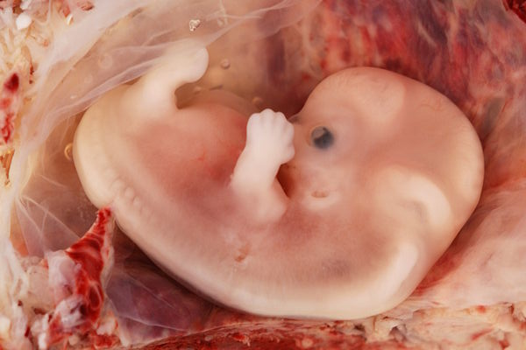
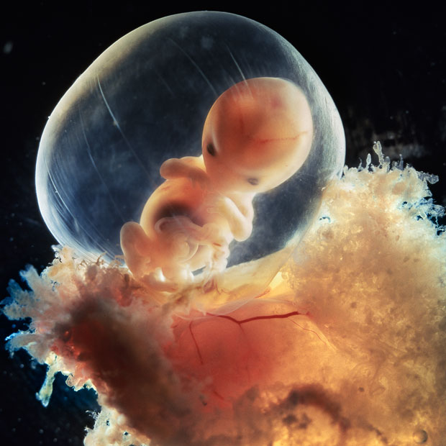
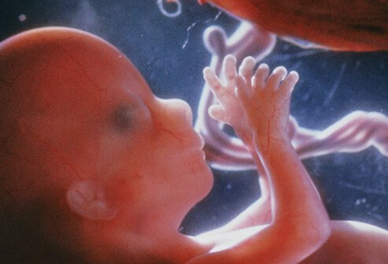
1st trimester cont.
2nd month
Limbs take shape, major organs can be seen.
Little to no actual growth in size occurs, just specialized organ development. Weight: 1 gram
3rd Month
Nervous system develops reflexes like suckling.
Corpus luteum’s hormones are replaced by the placenta
Week 10 the heartbeat becomes audible with special instrumentation.
Mammary glands are stimulated to prepare for milk production.

Slide 27
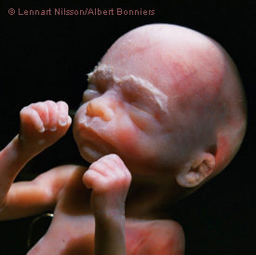
2nd Trimester – less development/ more growth.
Bones get bigger and muscles develop.
Mother can feel the fetus kick
Weight has increased to 600 grams
Heartbeat can be heard with a stethoscope.

Slide 28
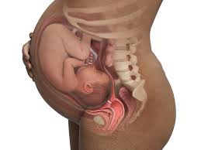
3rd Trimester – Growth, growth, growth
Packing on fat under the skin in addition to growing in size. Getting ready for survival outside the womb.
Lung maturation occurs
Nervous system undergoes massive mitosis of neurons. 15 million per hour and will continue for a short time after birth.

Slide 29
Parturition – (Birth)
Stage 1
Initiation of contractions and dilation of cervix to 10cm.
Caused by baby’s size and stretching of uterus
Oxytocin (hormone) is released which results in contractions.

Slide 30
Stage 2 – Delivery of the baby
The head passes through the cervix and vagina. Baby is pushed out by strong uterine contractions and mother “bearing down”
Umbilical cord is usually clamped and cut.

Slide 31
Stage 3 – delivery of the placenta
Occurs after a brief relaxation after the baby is born. (within minutes)

Slide 32
Lactation
Lactation is stimulated by the hormone prolactin and the baby’s suckling.
First secretion is colostrum, a high protein and antibody rich product for nourishment and protection.
Gradually colostrum is replaced by milk.
Lactation can prevent ovulation for some time after birth.

