Slide 1
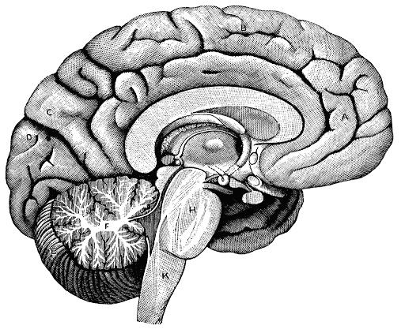
Nervous System

Slide 2
Standards
SC.912.L.14.26 Identify the major parts of the brain on diagrams or models.
SC.912.L.14.27 Identify the functions of the major parts of the brain, including the meninges, medulla, pons, midbrain, hypothalamus, thalamus, cerebellum, and cerebrum.

Slide 3
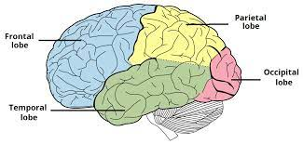
Cerebrum/ Cerebral Cortex: 4 lobes
Frontal Lobe – Complex decision making, spacial reasoning, motor movement (including speech), and memory for these tasks, etc.
Temporal lobe – Hearing, taste, making sense of language and memory for these tasks.
Parietal Lobe – Sensory input, provides meaning for sensations, memory for touch sensations.
Occipital Lobe – Vision and meaning (memory) for vision.

Slide 4
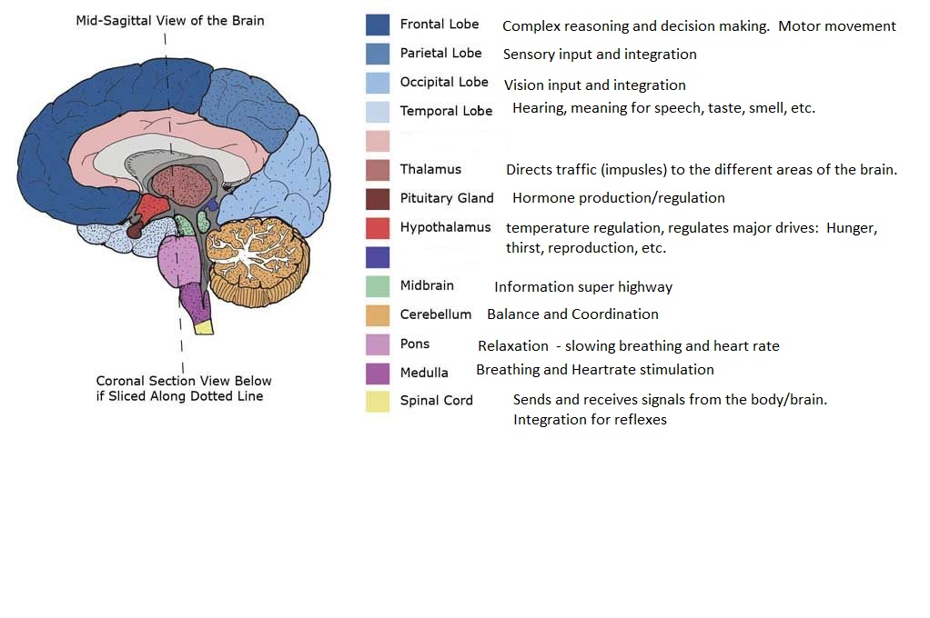

Slide 5
Meninges – A membrane covering for the brain and spinal cord. Produces Cerebral Spinal Fluid (CSF). Without CSF, the brain would be damaged under its own weight.
Provides cushioning for the brain within the skull.
Circulates resources and moves waste.

Slide 6
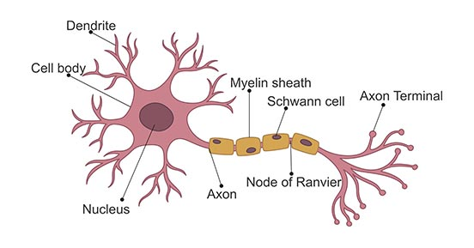
How does it work?
The brain, spinal cord, and all the peripheral nerves are made of neurons and support cells.
Signals are sent via change in electrical charges on the surface of neurons. (movement of ions into and out of cell membranes). This change is called an action potential.
Sensory nerves send information to the brain and spinal cord, Motor neurons send information from the brain and spinal cord to the muscles and organs.

Slide 7
Quiz yourself on parts of the brain and functions

Slide 8
Cardiovascular System

Slide 9
SC.912.L.14.36 Describe the factors that affect blood flow through the cardiovascular system
The anatomy of the heart
Anatomy of arteries and veins
Blood pressure

Slide 10
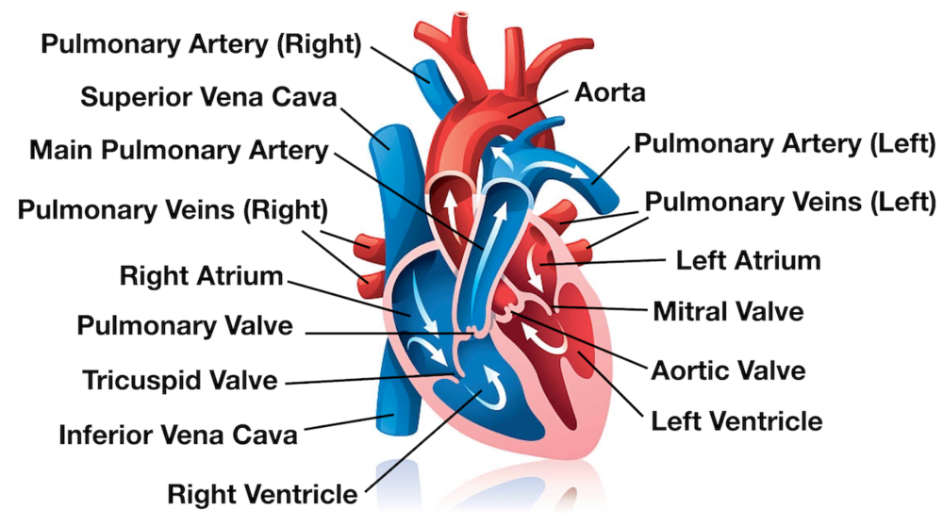

Slide 11
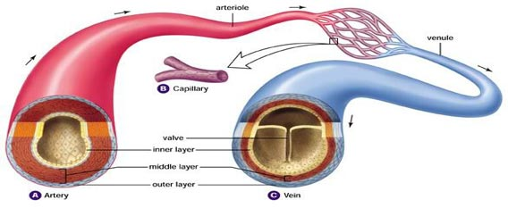
Anatomy of arteries and veins

Slide 12
Blood pressure
The amount of force placed on the arterial walls when the heart contracts, and when it rests. Measured in mmHg.
Normal BP is 120/80 120 represents the systolic measure (pressure when the heart contracts) 80 represents the diastolic measure (pressure when the heart relaxes between beats).
Blood pressures that are too low make it difficult to push blood against gravity to the brain.
Blood pressures that are too high run a higher risk of blood vessel rupture.

Slide 13
What makes up blood?
Hematocrit: list of all the parts that make up blood and the percentage of blood they compose.
Plasma – about 55% of blood - made of 90% water, 10% resources and waste.
Red blood cells – about 45% - carries Oxygen/Carbon dioxide
White blood cells – about 1% - immune system cells
If the blood is too thick, it is too difficult to pump. If it is too thin, it won’t have enough cells to complete its function properly.

Slide 14
What can change blood flow in a closed system?
Blood vessel dilation
Blood vessel constriction
Length of blood vessels
Damage to blood vessels
Venus valves not functioning properly
Cholesterol or other deposits in arteries
Heart valves not functioning properly
Heart muscle cells not contracting properly
Hydration levels
Hematocrit
Blood pressure!

